Slide 1
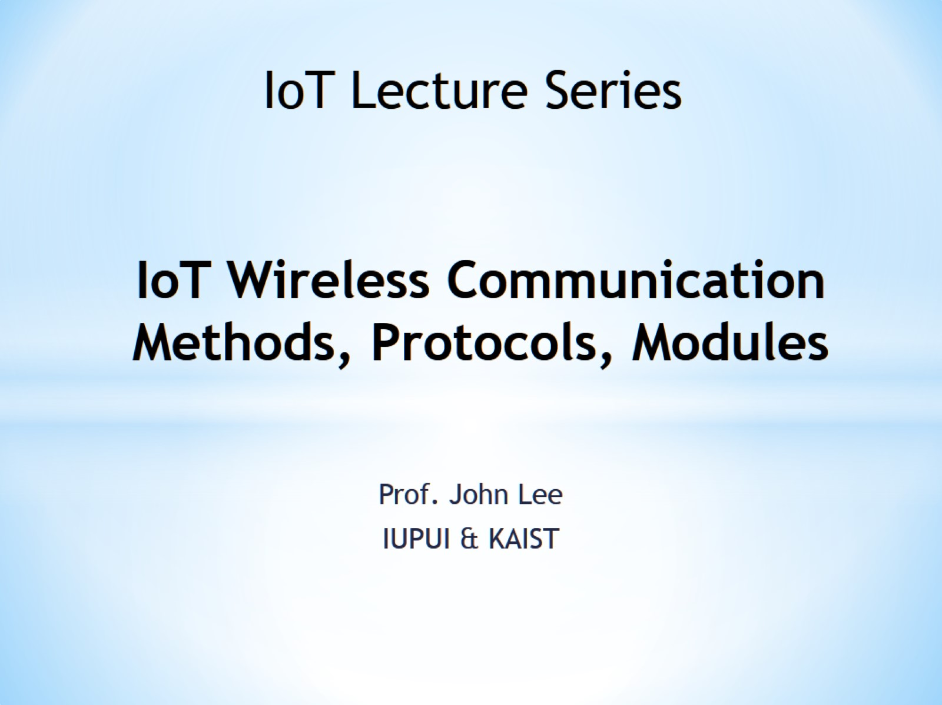
IoT Wireless Communication Methods, Protocols, Modules

Slide 2
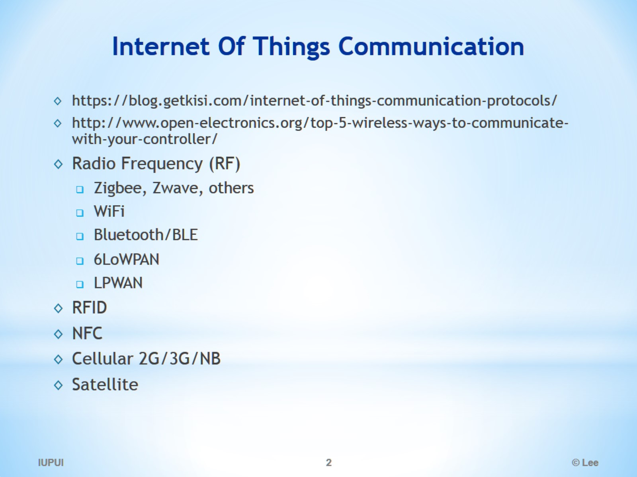
Internet Of Things Communication

Slide 3
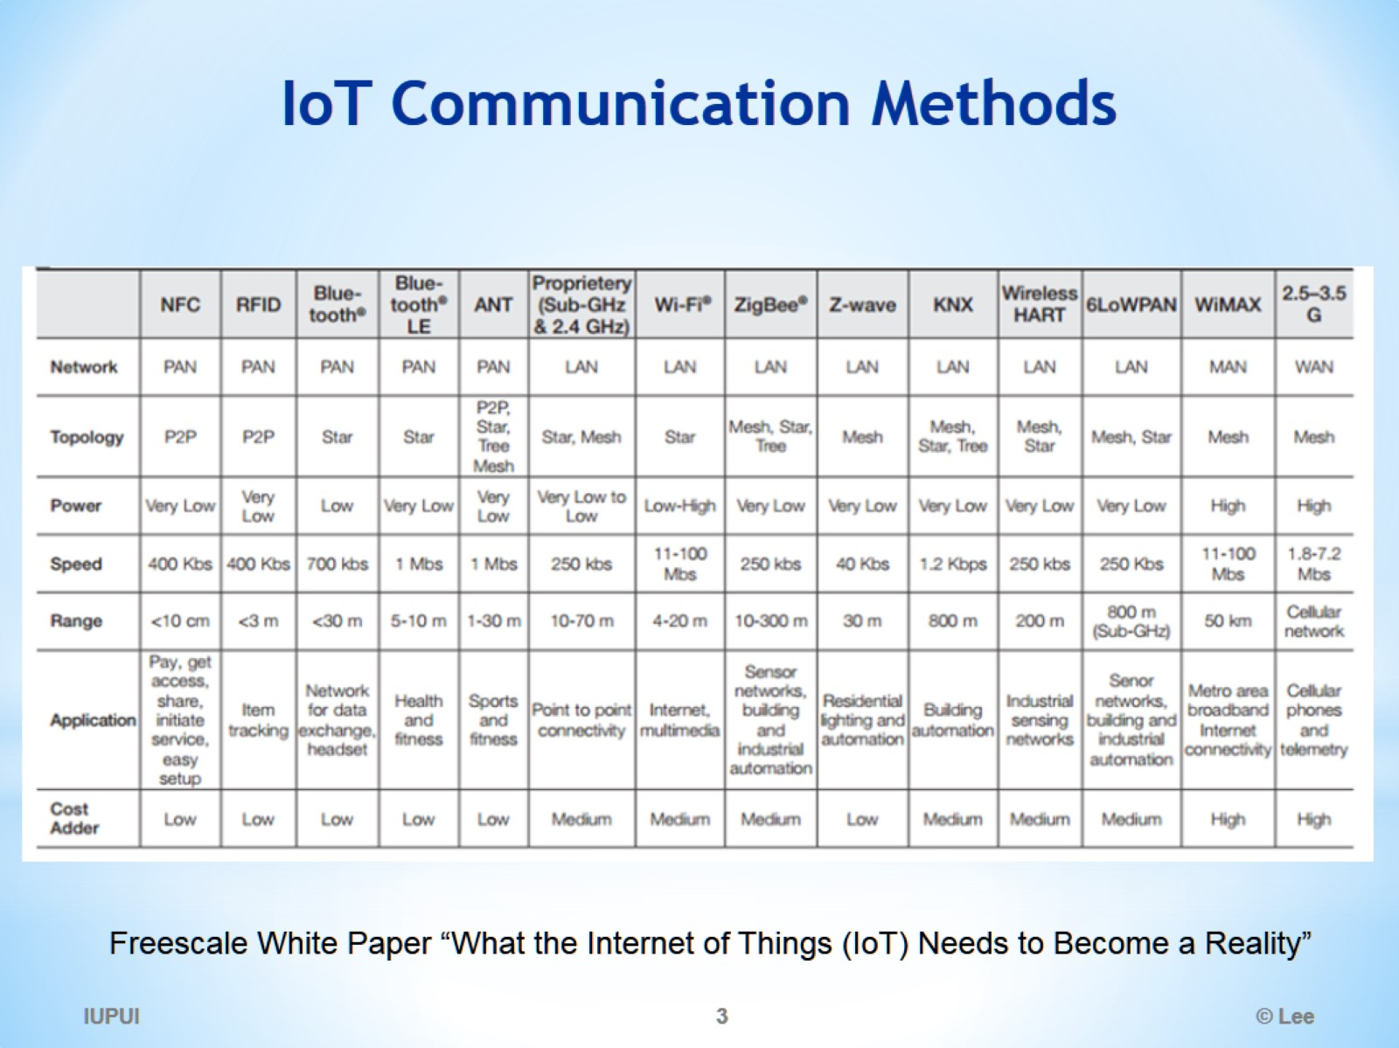
IoT Communication Methods

Slide 4
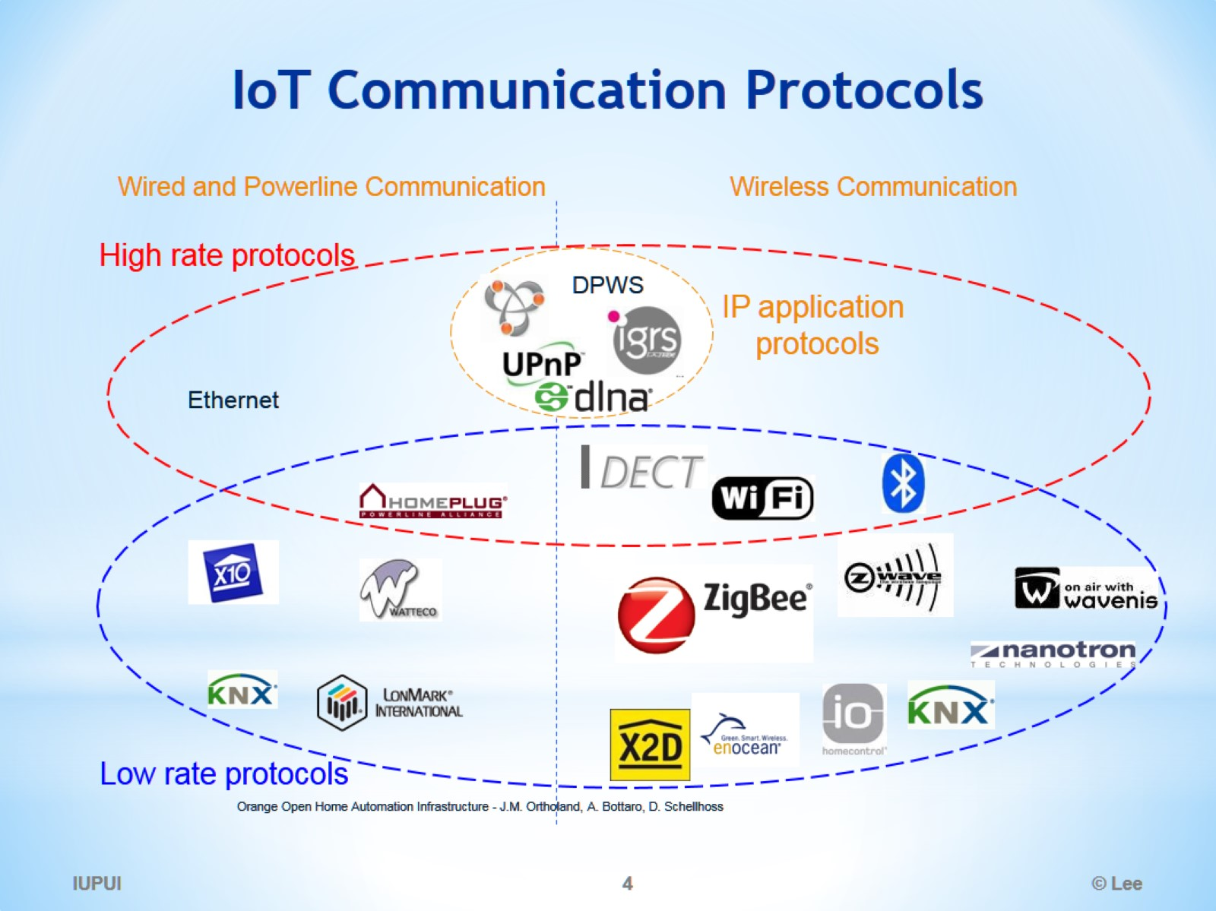
IoT Communication Protocols

Slide 5
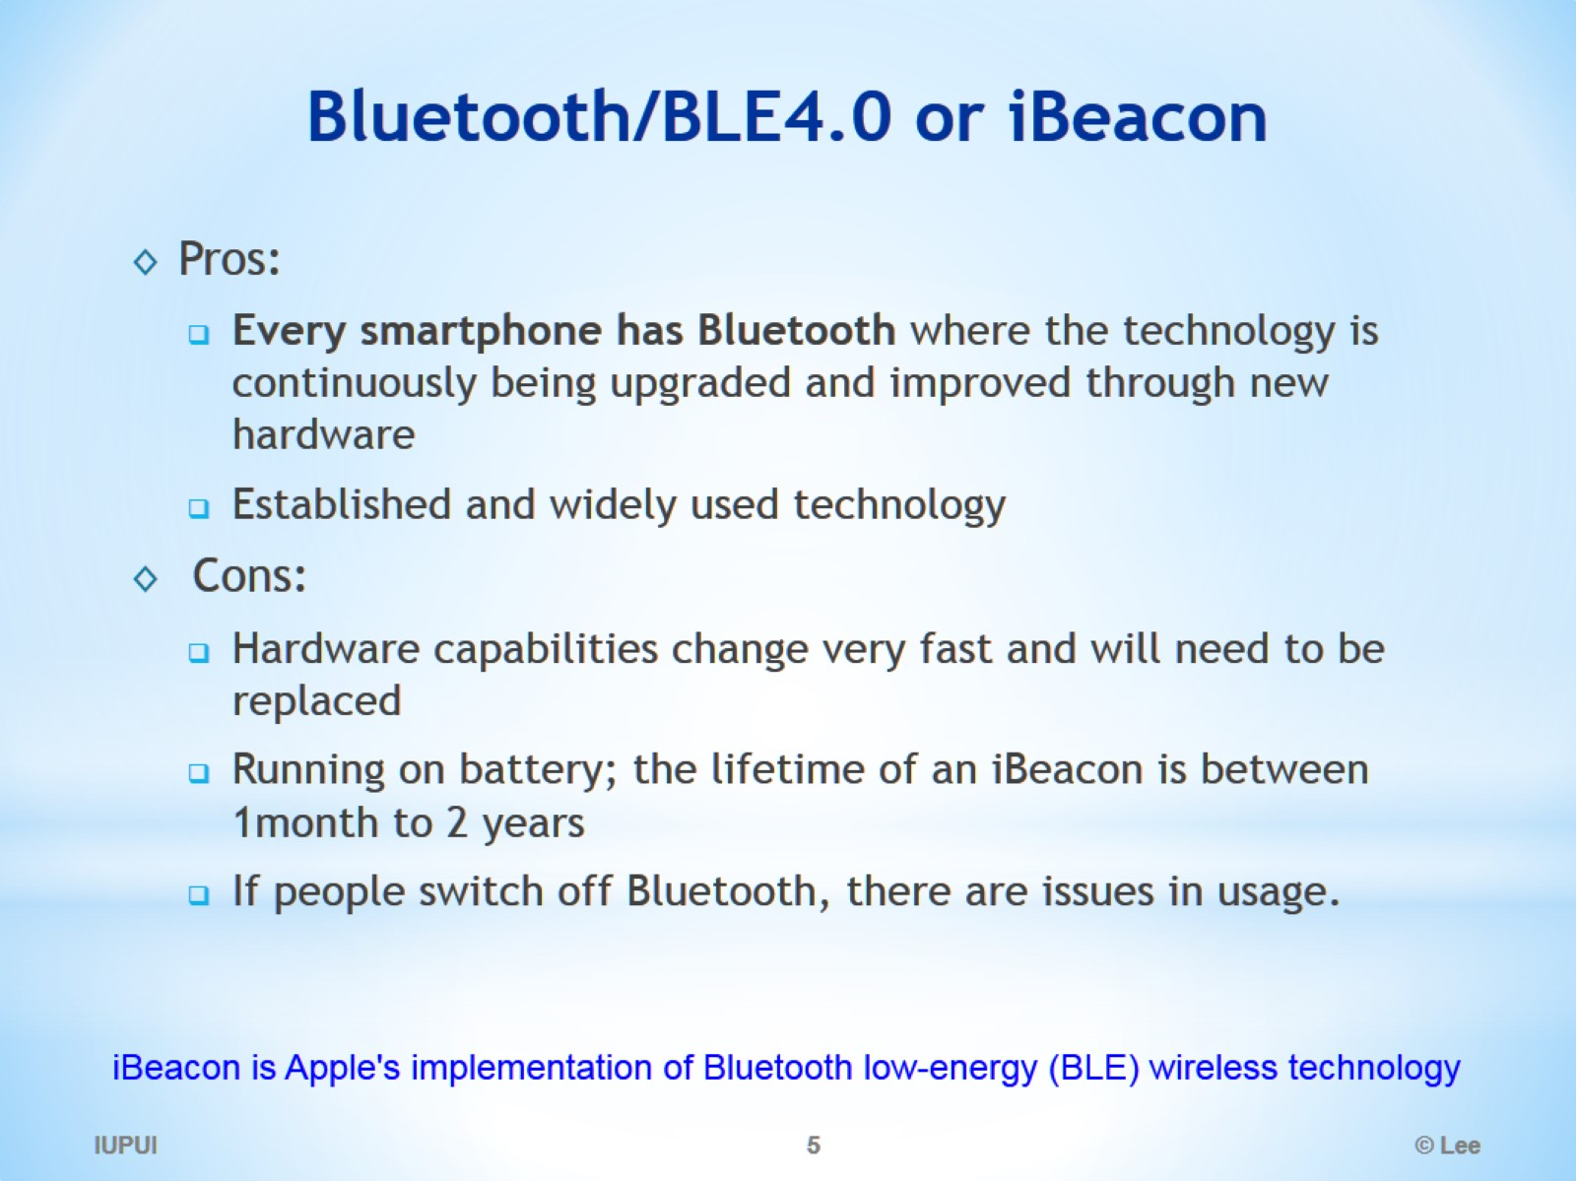
Bluetooth/BLE4.0 or iBeacon

Slide 6
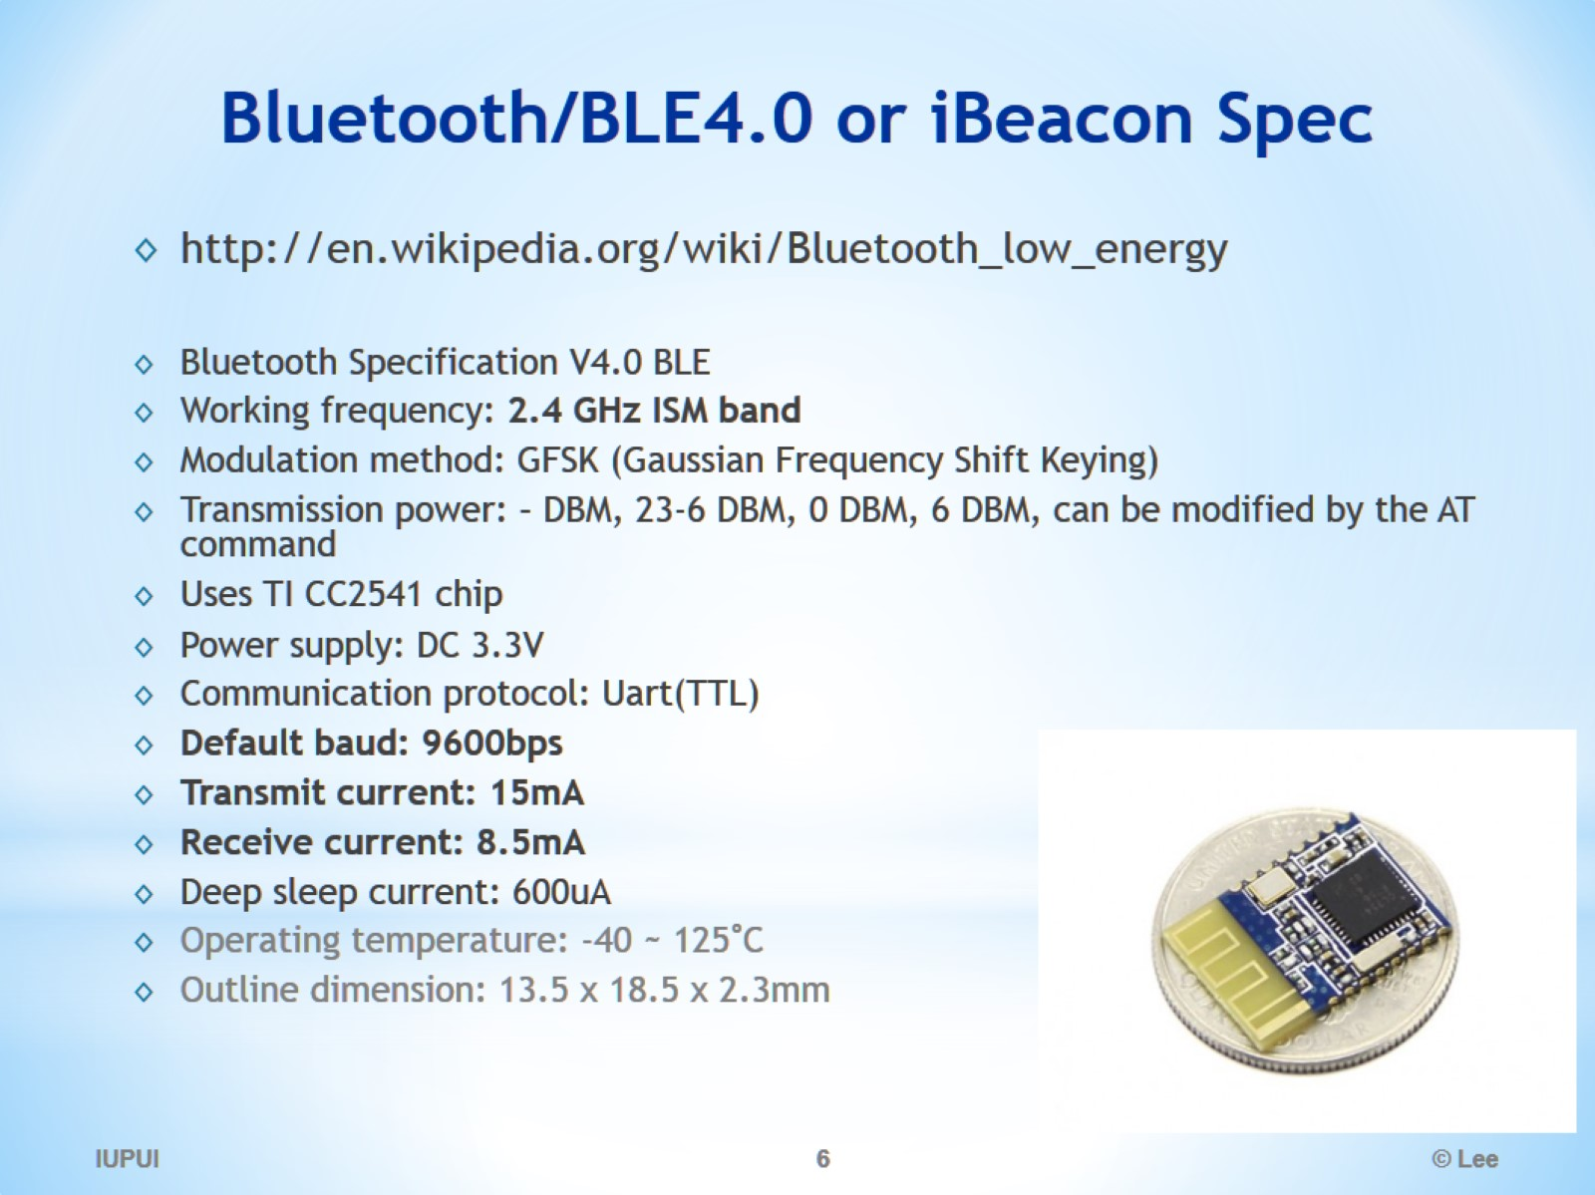
Bluetooth/BLE4.0 or iBeacon Spec

Slide 7
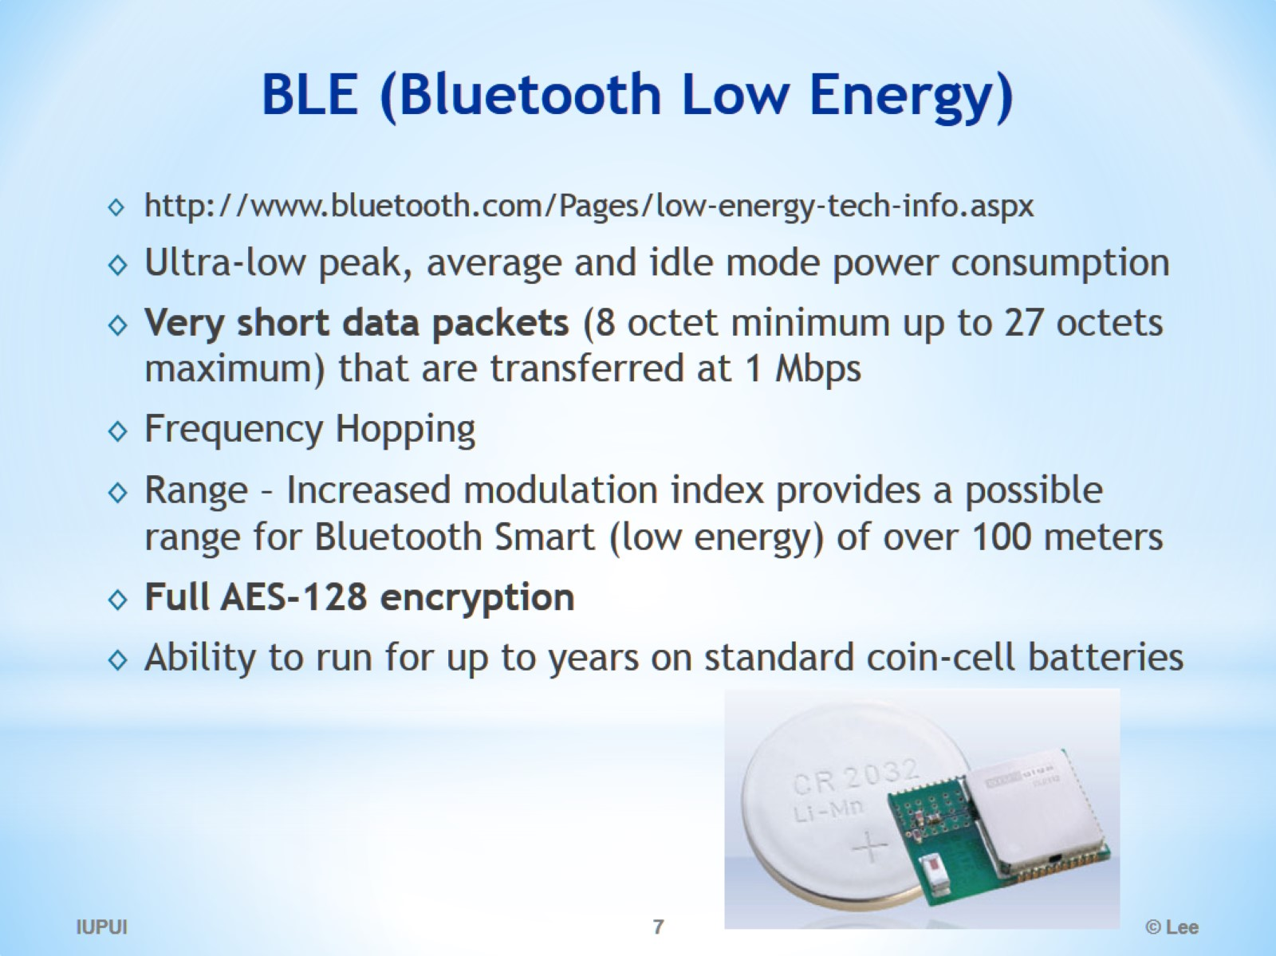
BLE (Bluetooth Low Energy)

Slide 8
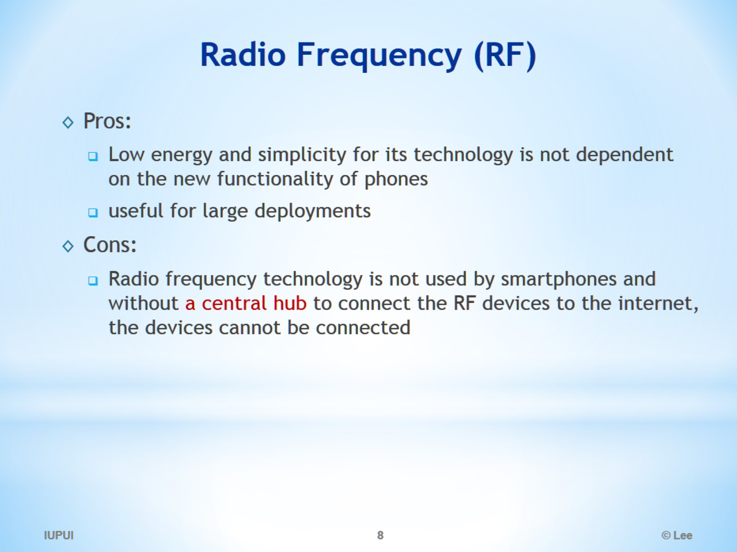
Radio Frequency (RF)

Slide 9
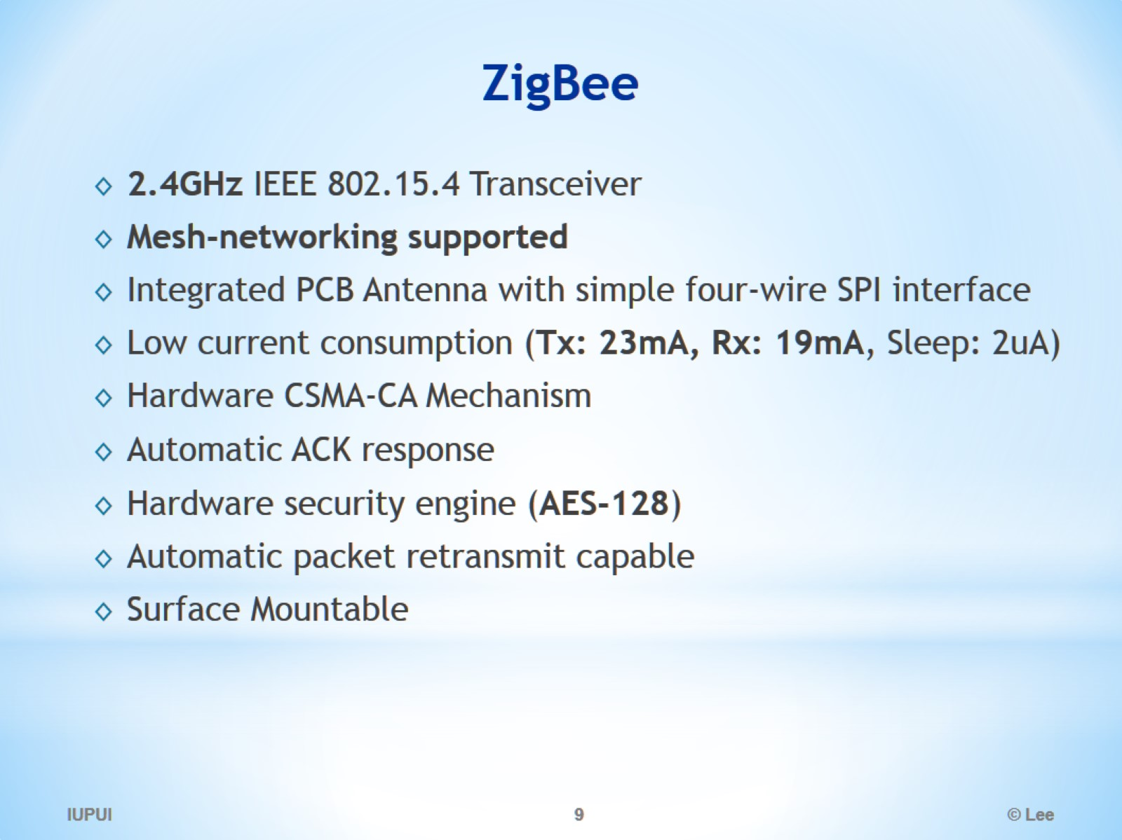
ZigBee

Slide 10
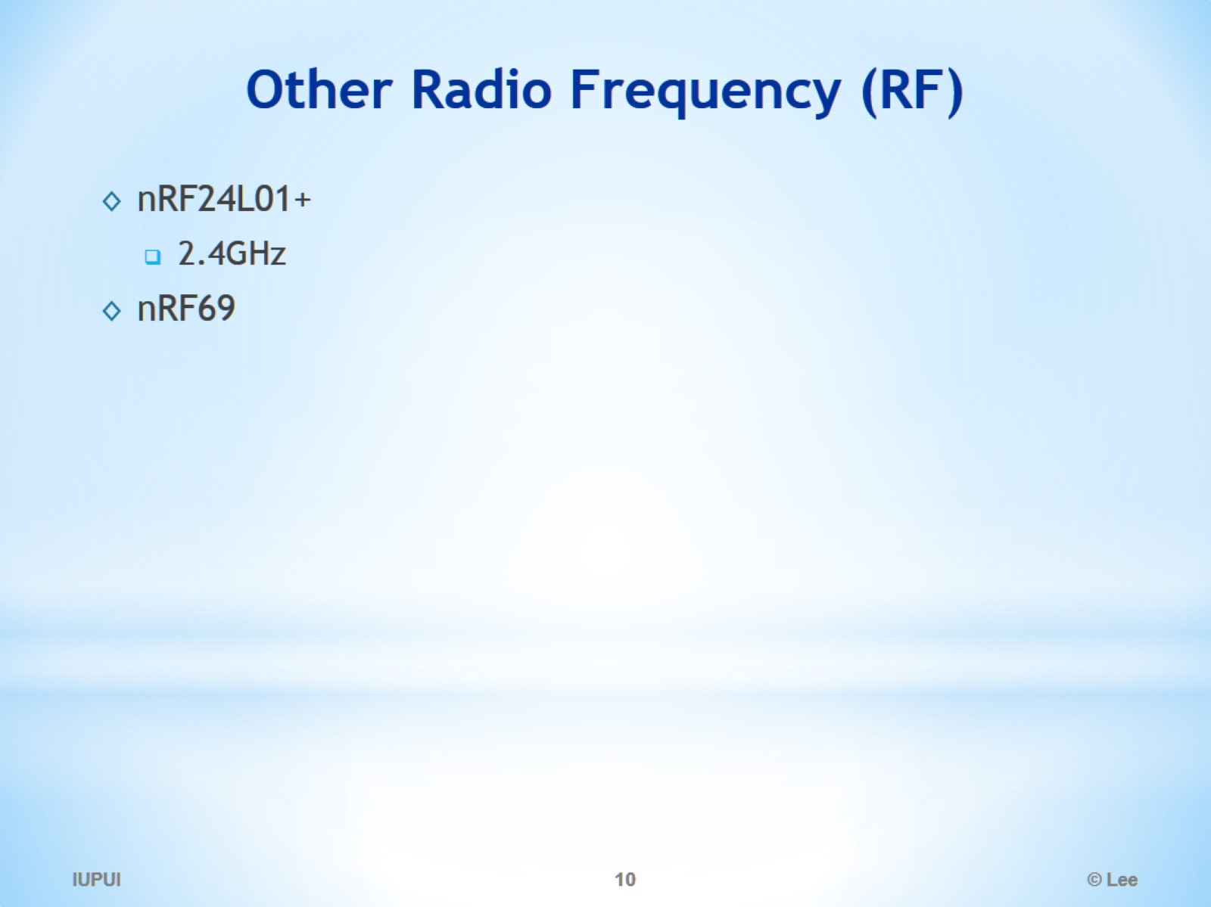
Other Radio Frequency (RF)

Slide 11
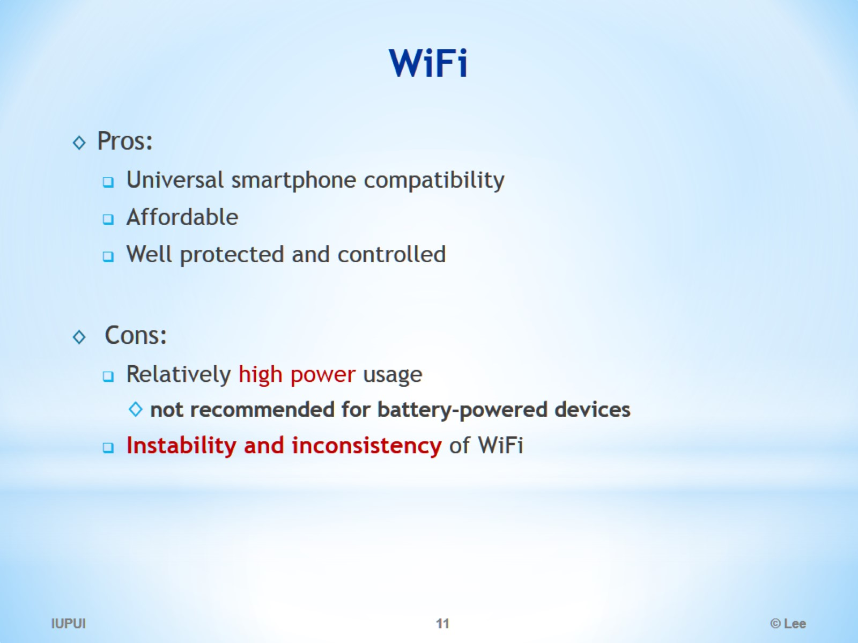
WiFi

Slide 12
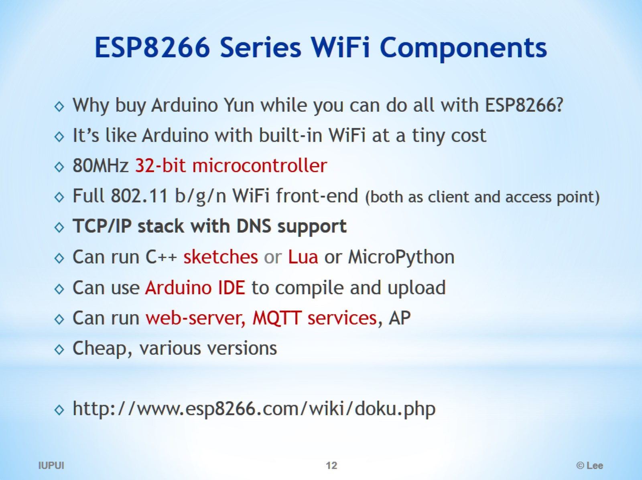
ESP8266 Series WiFi Components

Slide 13
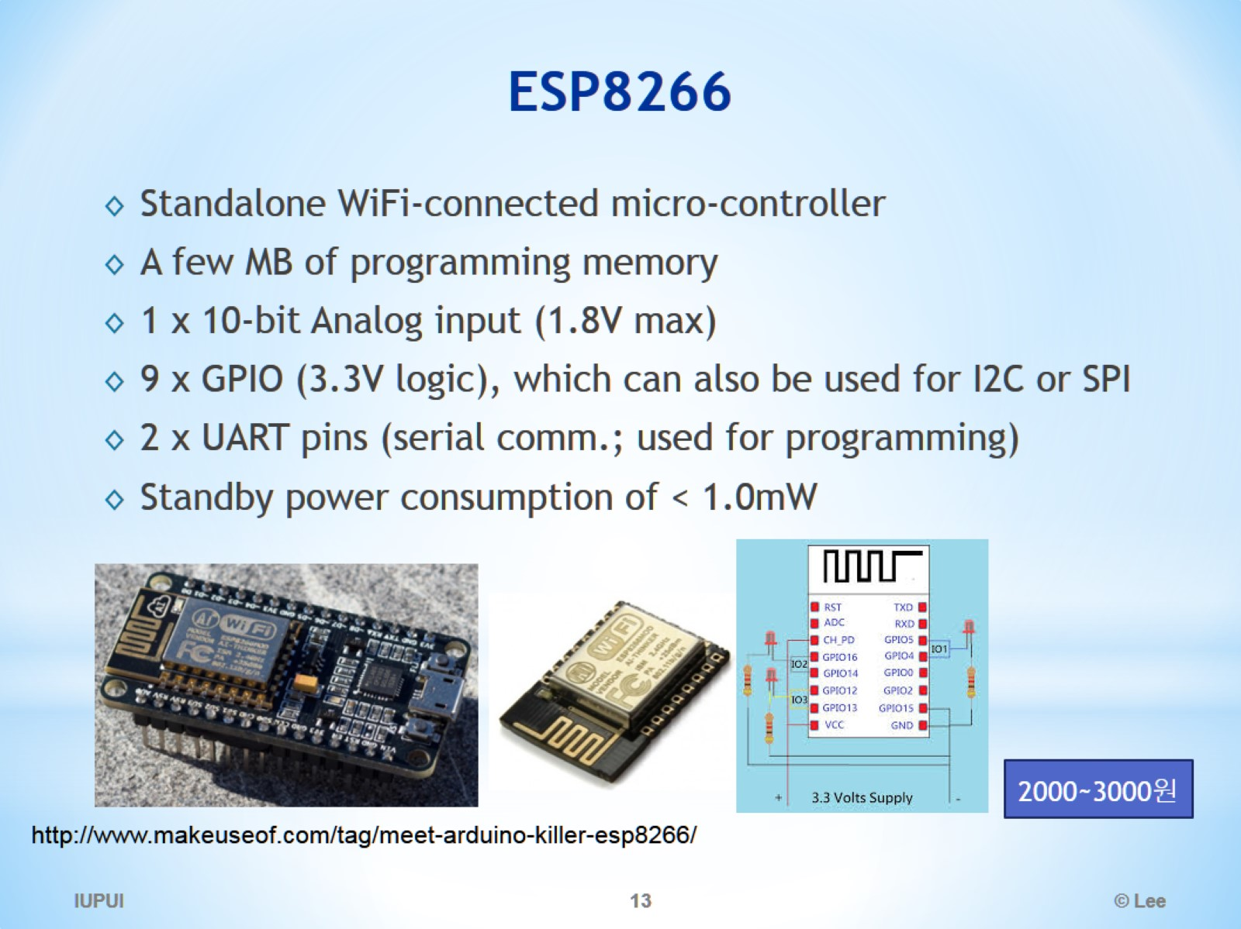
ESP8266

Slide 14
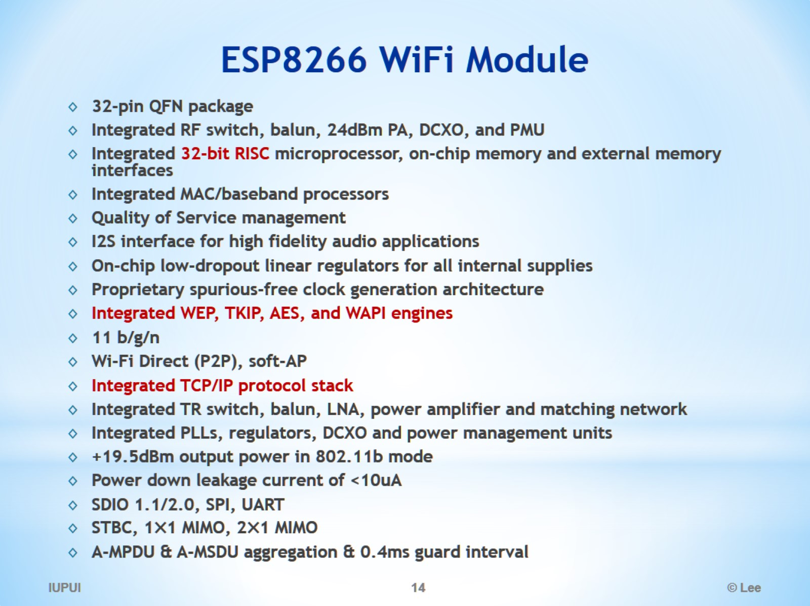
ESP8266 WiFi Module

Slide 15
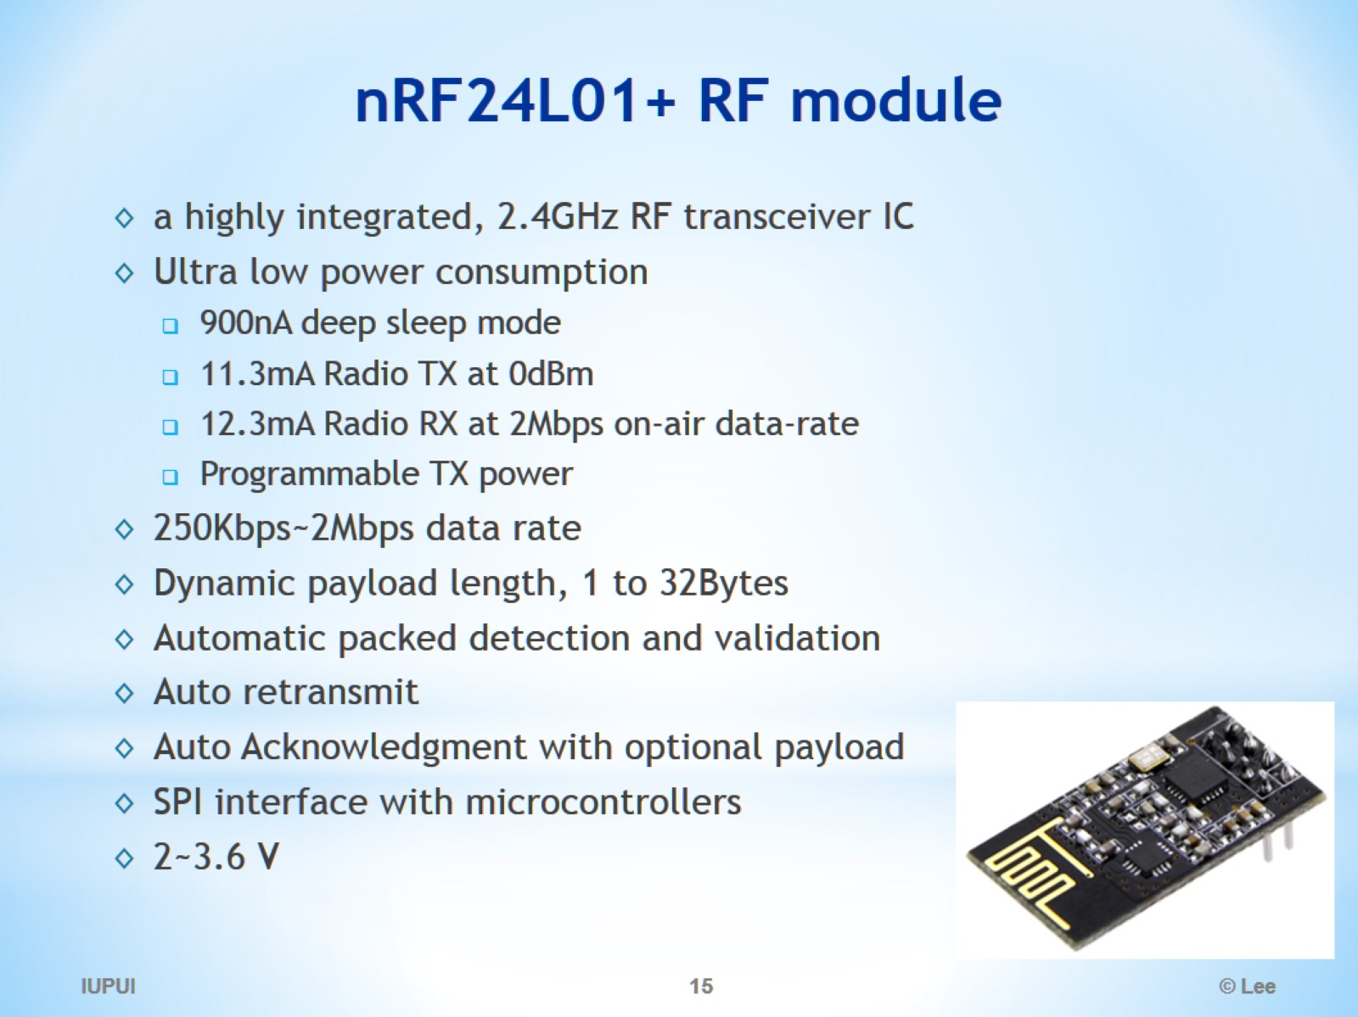
nRF24L01+ RF module

Slide 16
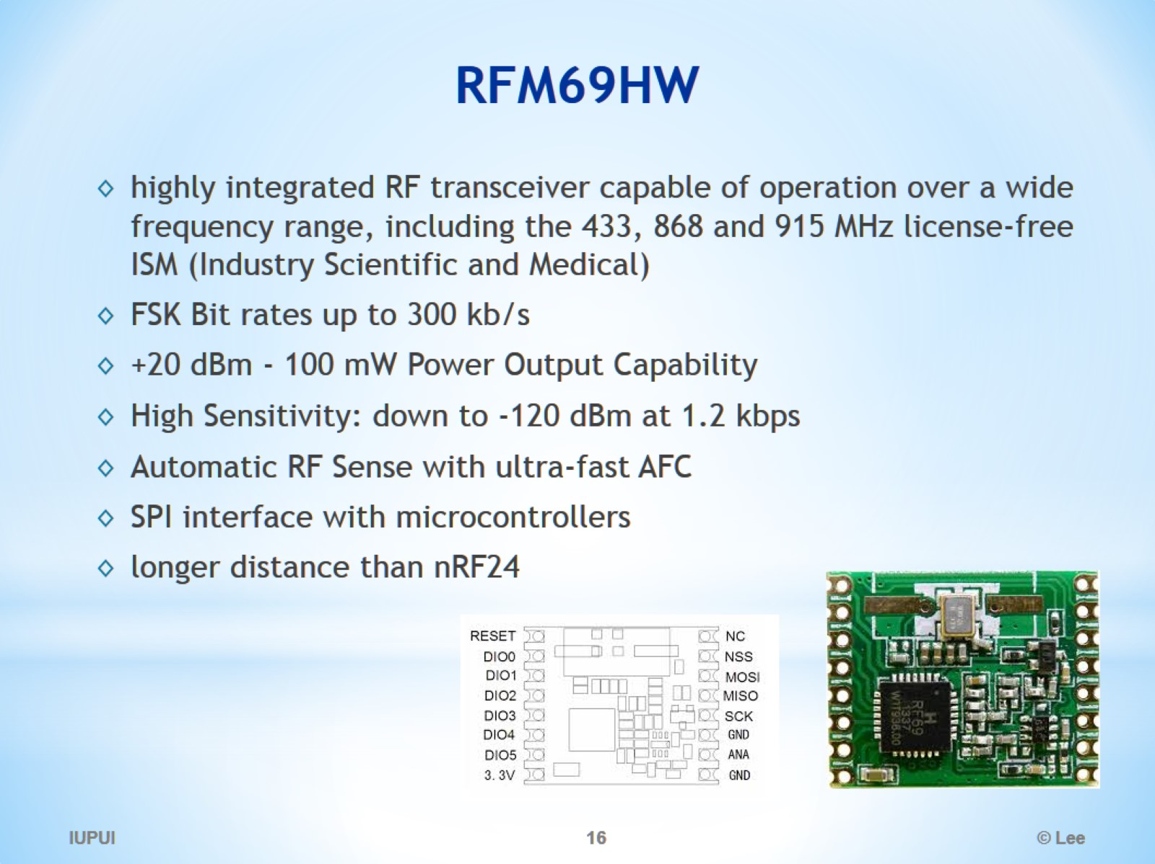
RFM69HW

Slide 17
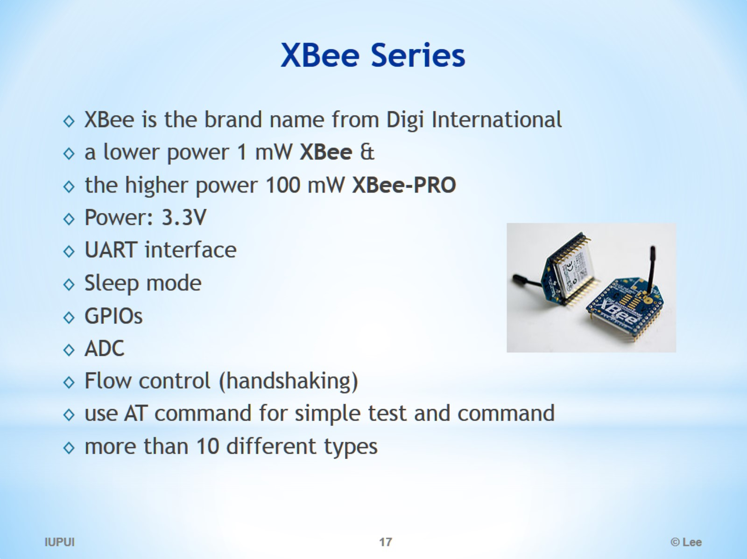
XBee Series

Slide 18
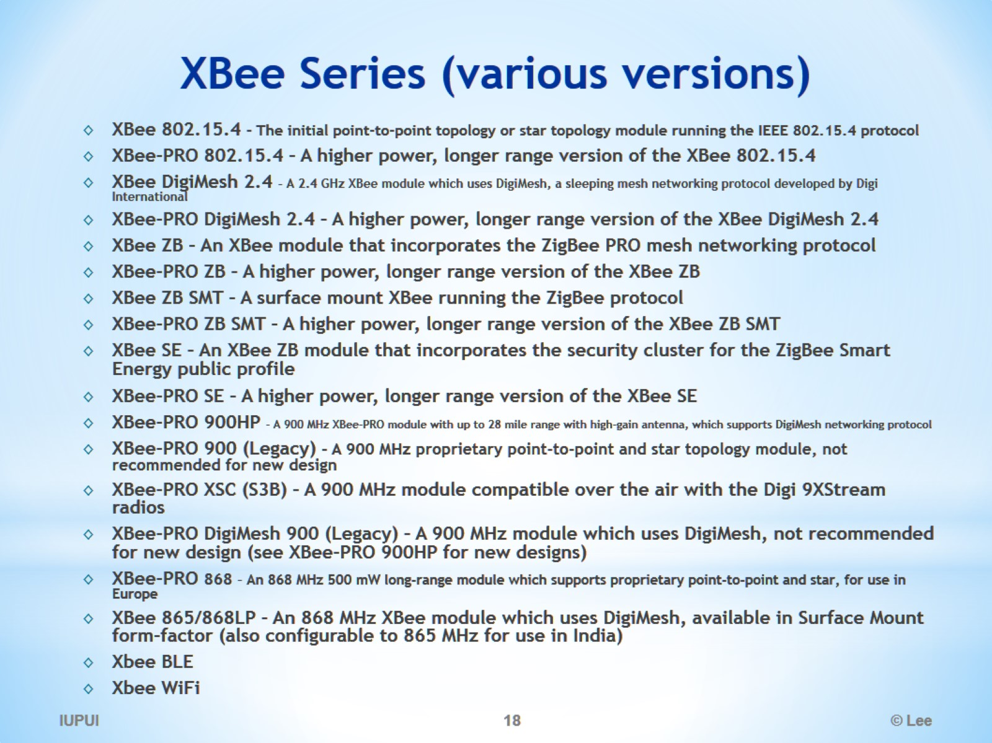
XBee Series (various versions)

Slide 19
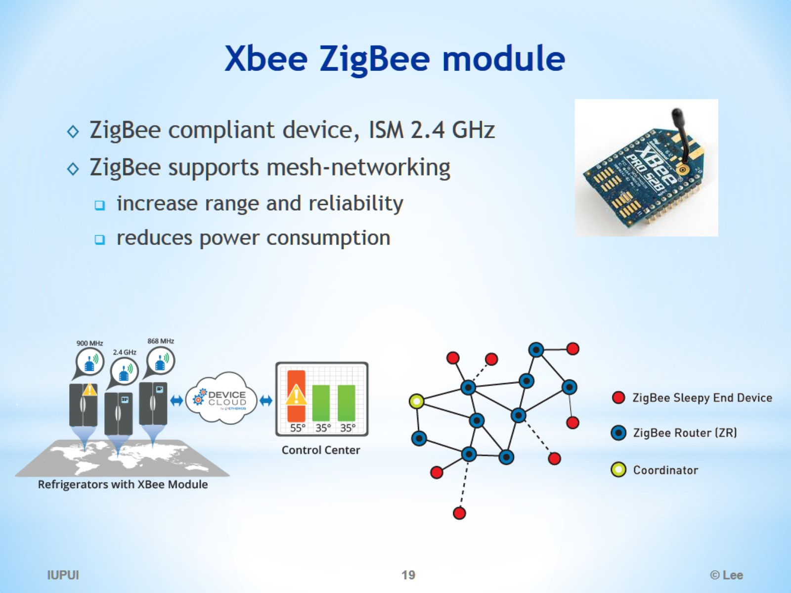
Xbee ZigBee module

Slide 20
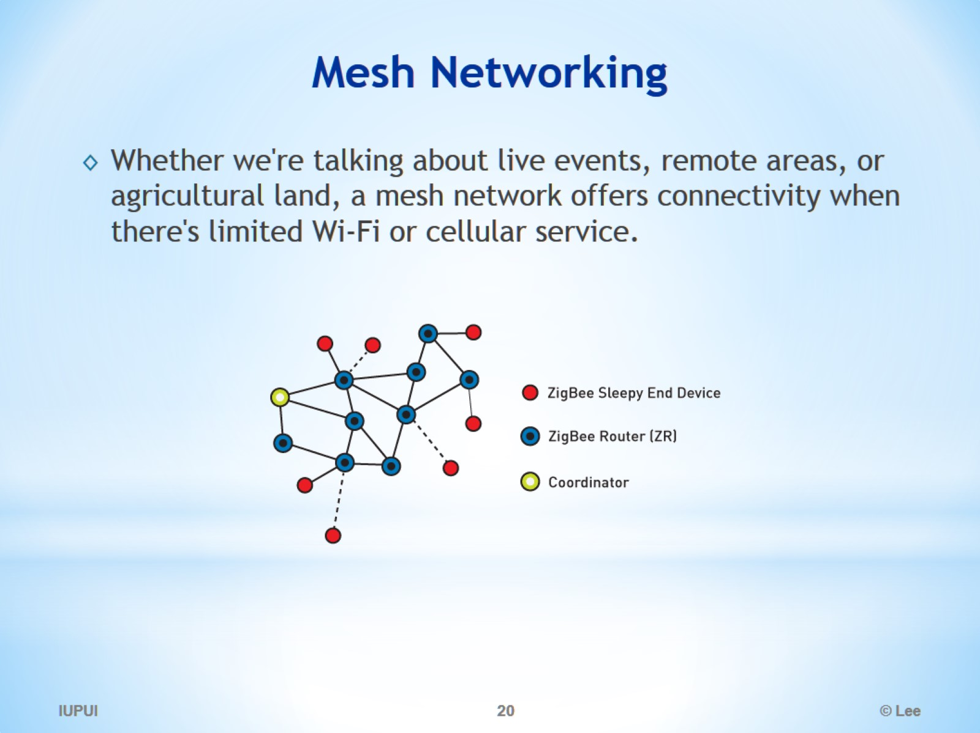
Mesh Networking

Slide 21
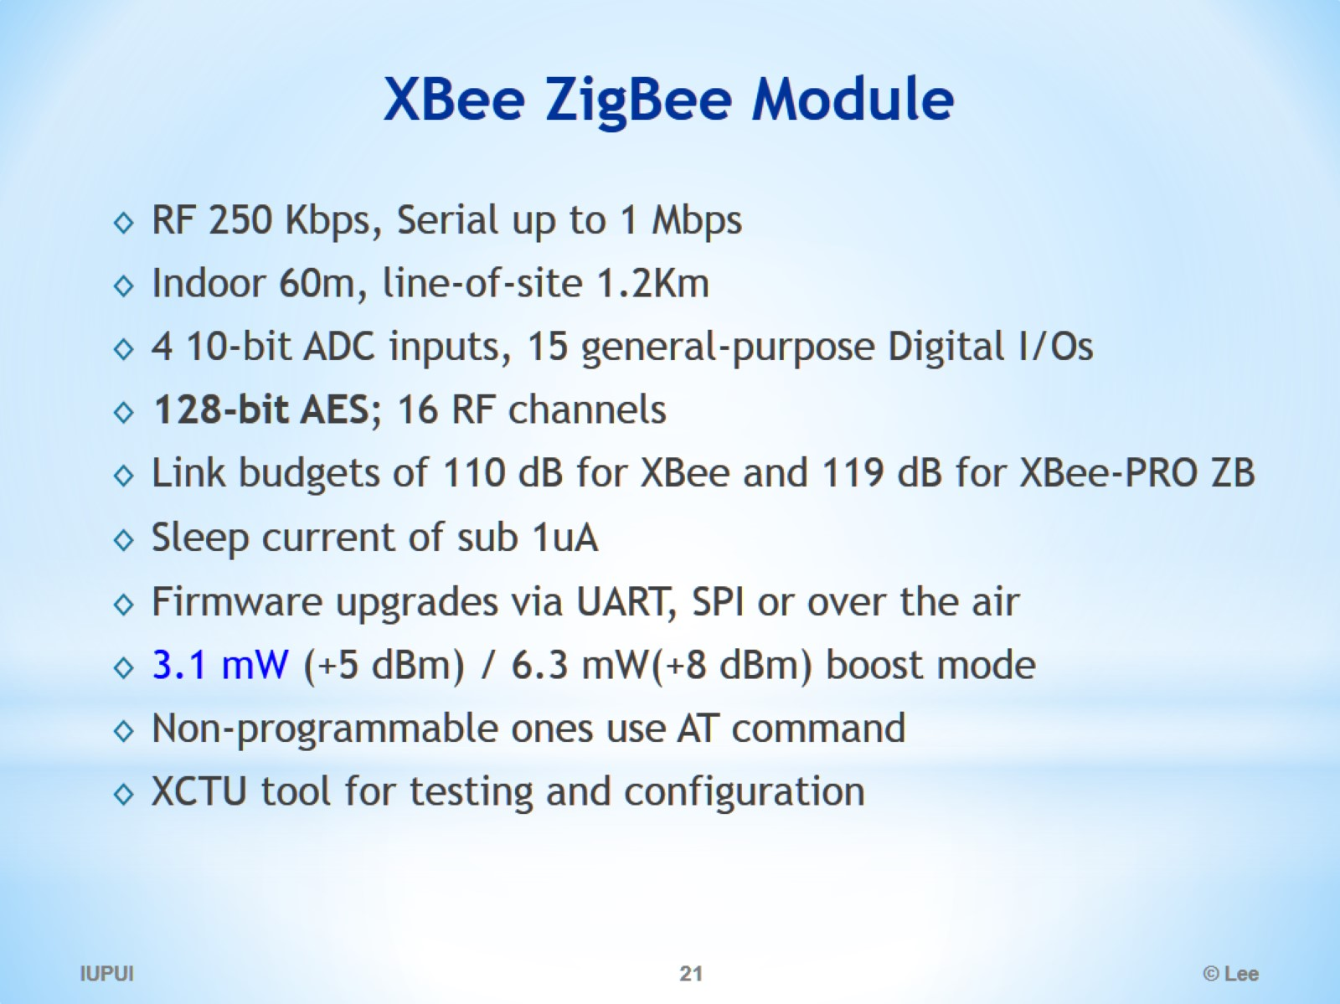
XBee ZigBee Module

Slide 22
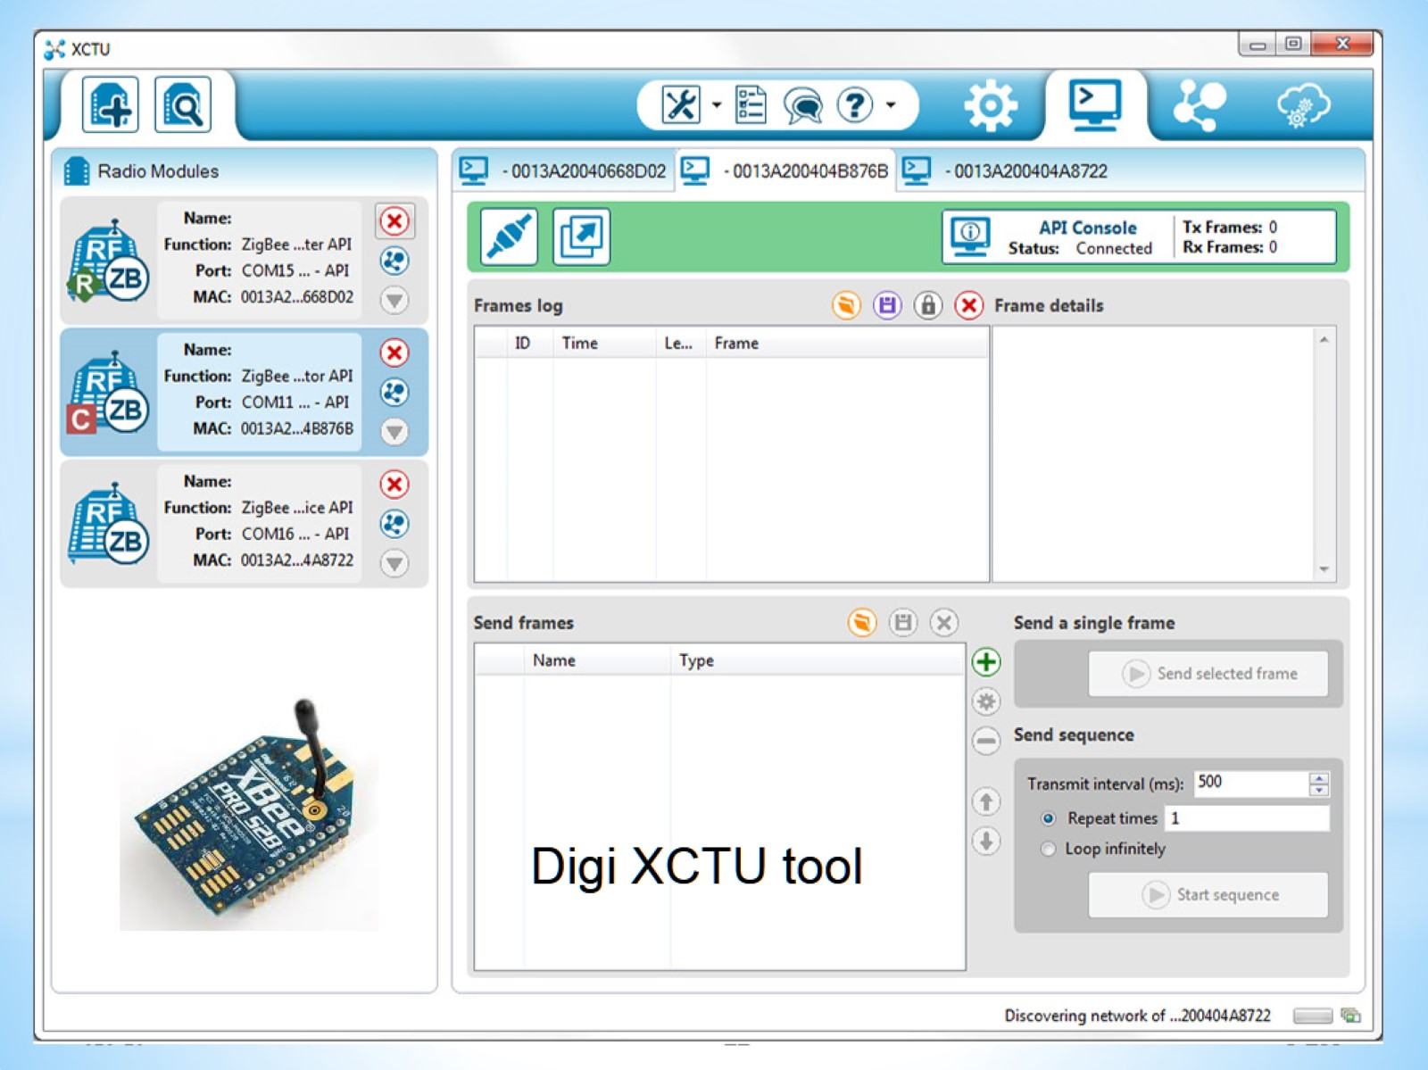
XCTU

Slide 23
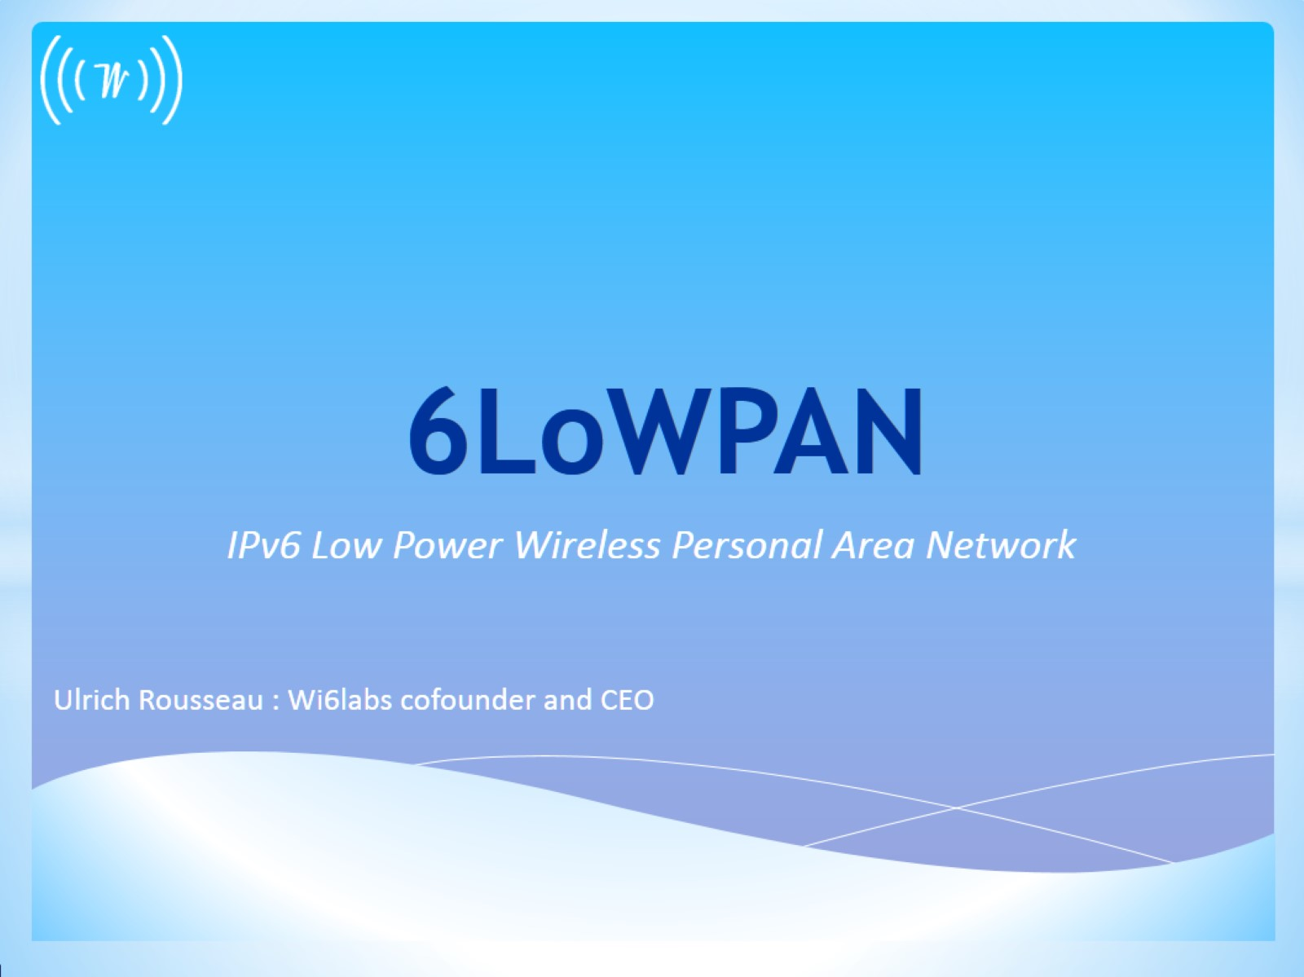
6LoWPAN

Slide 24
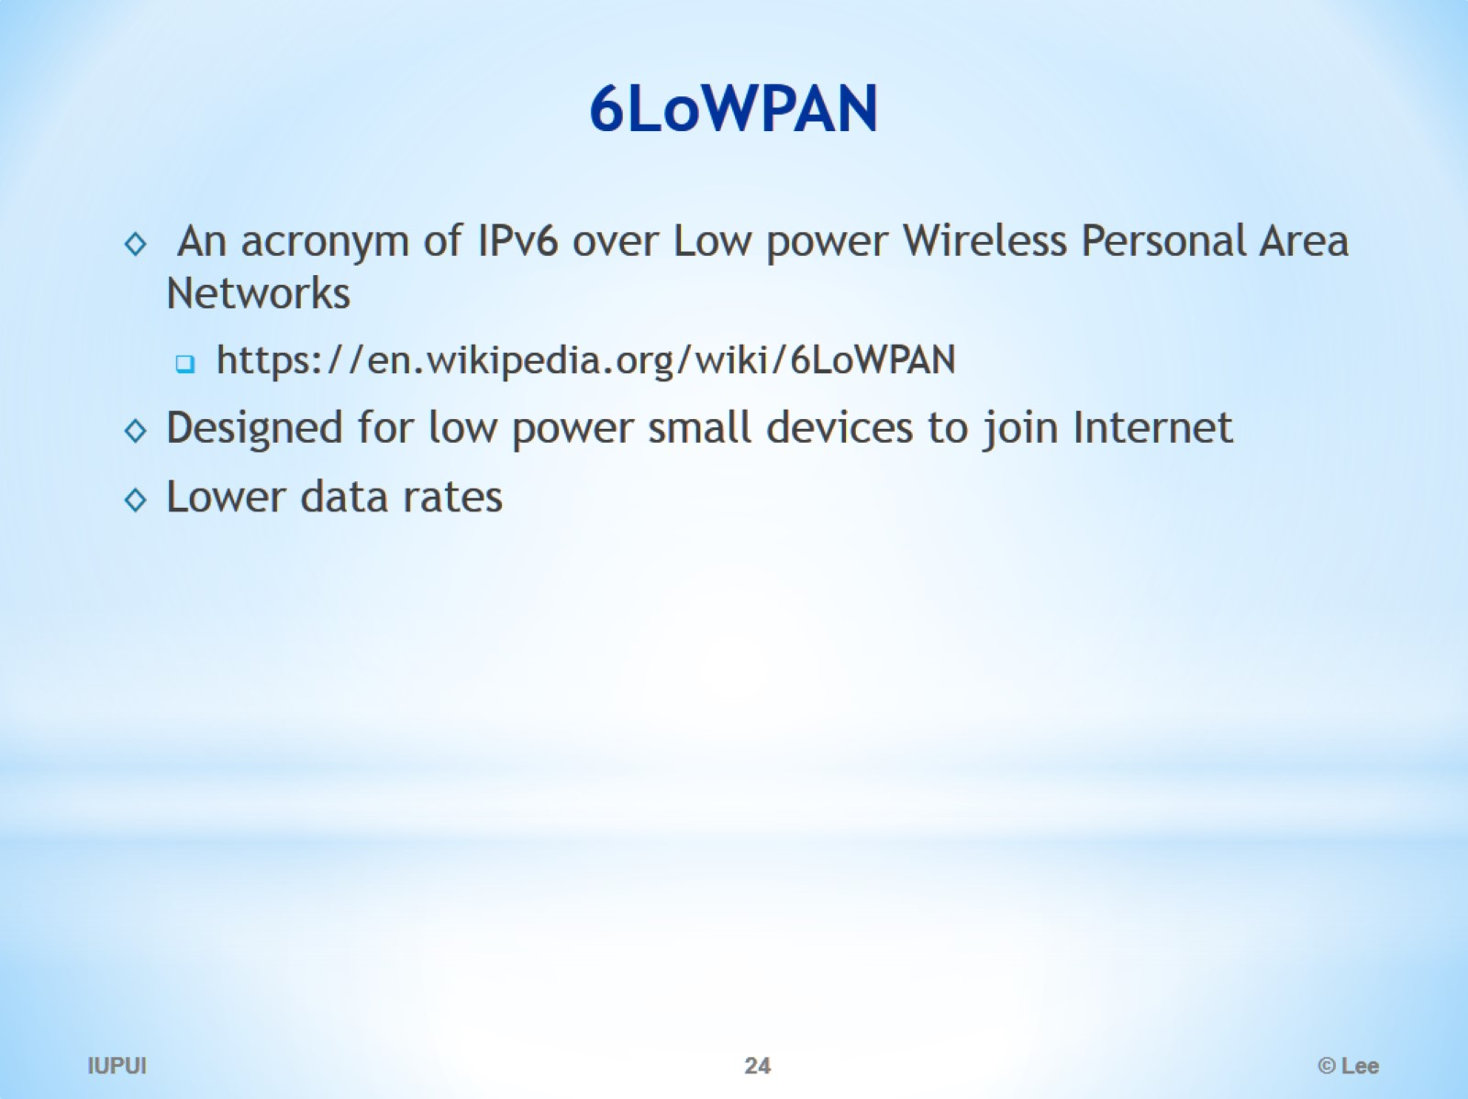
6LoWPAN

Slide 25
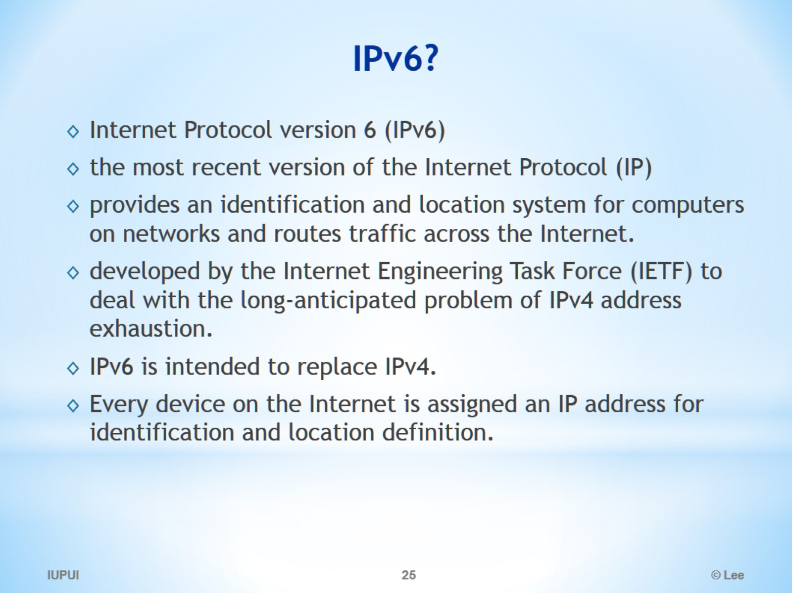
IPv6?

Slide 26
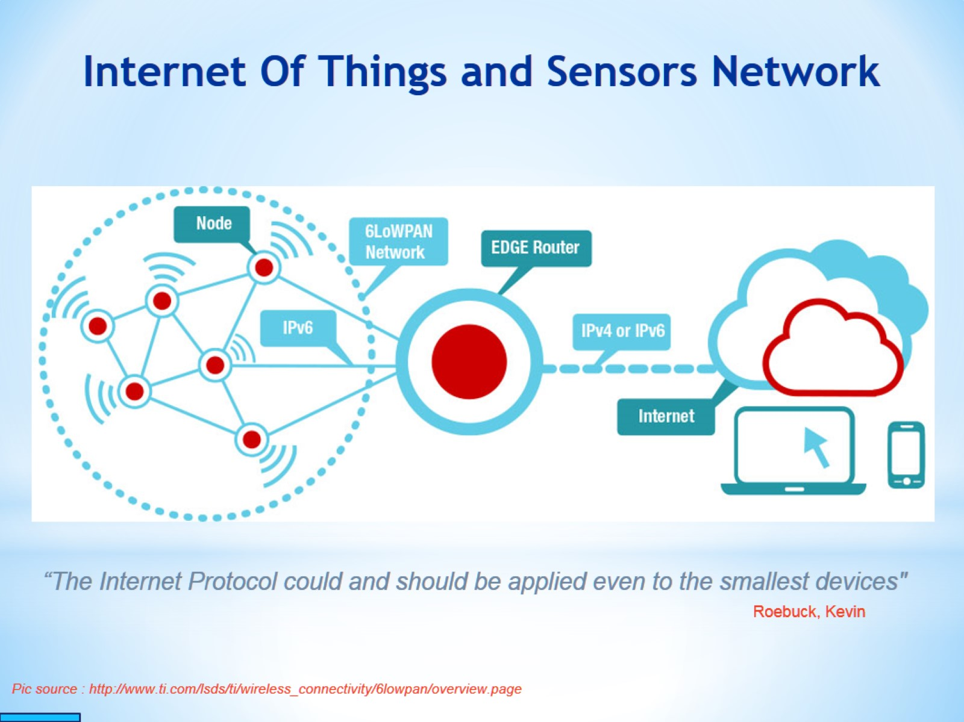
Internet Of Things and Sensors Network

Slide 27
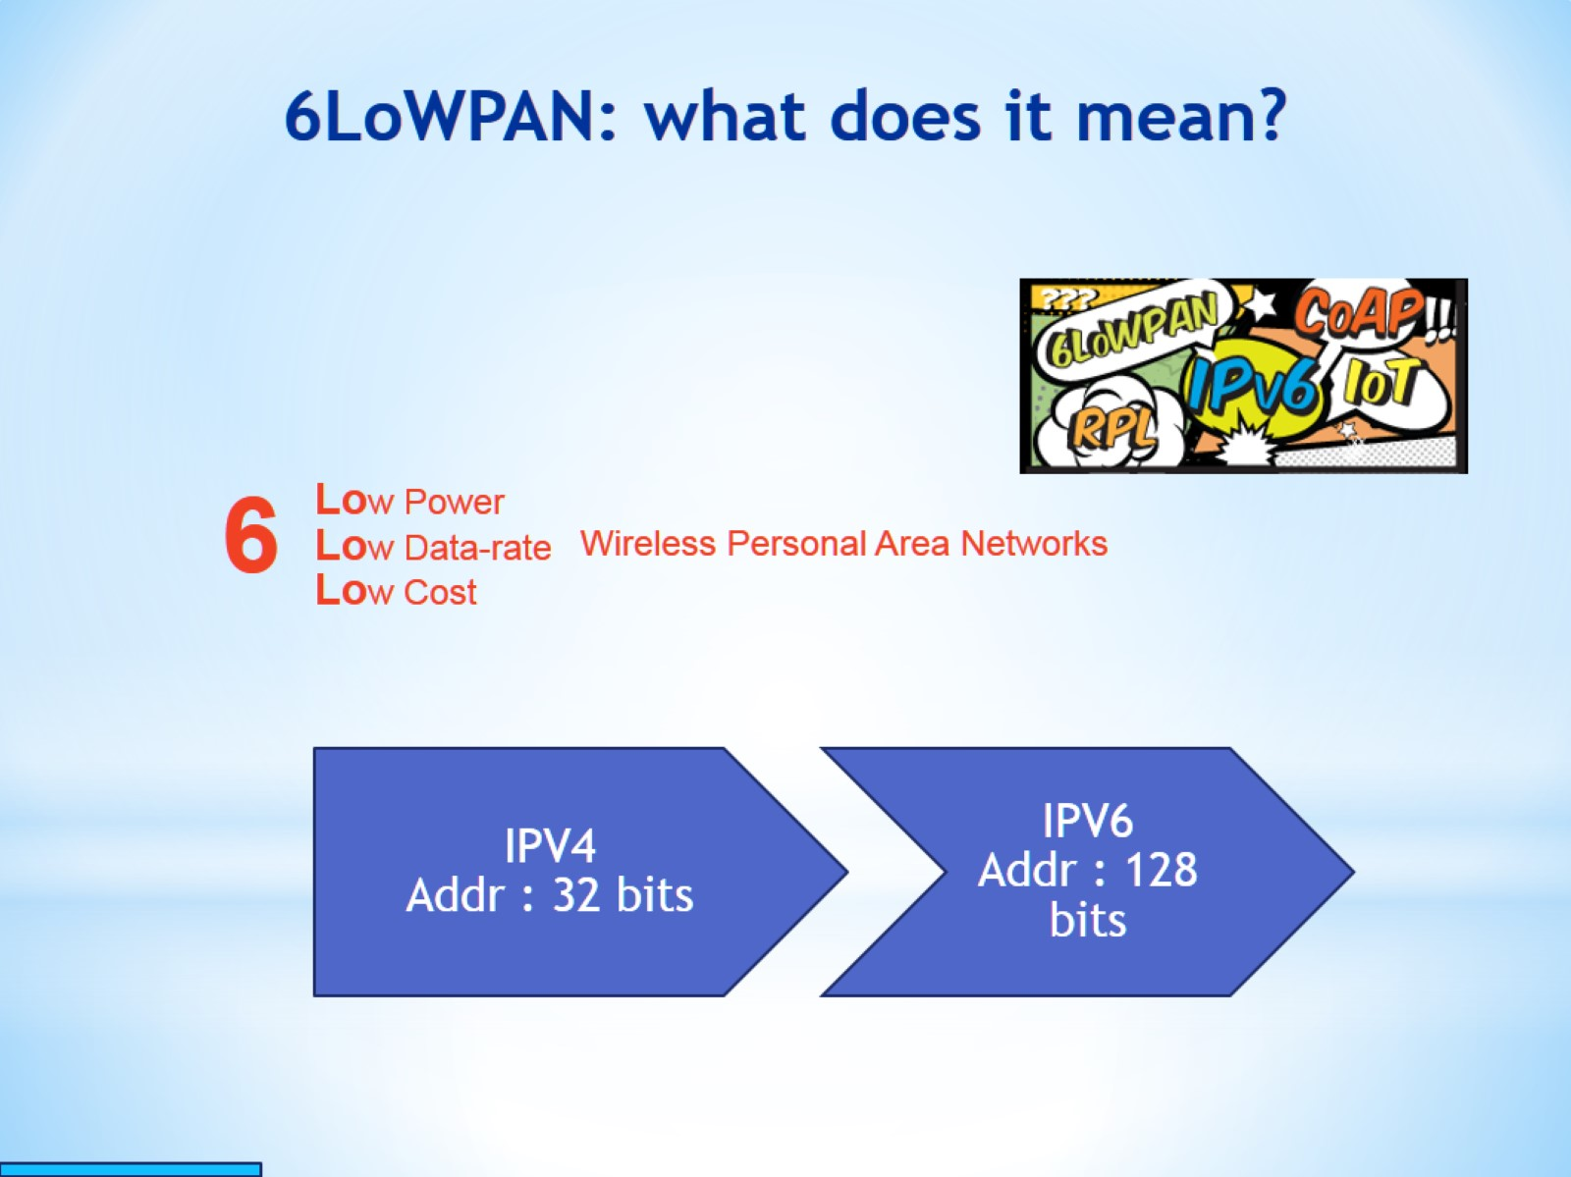
6LoWPAN: what does it mean?

Slide 28
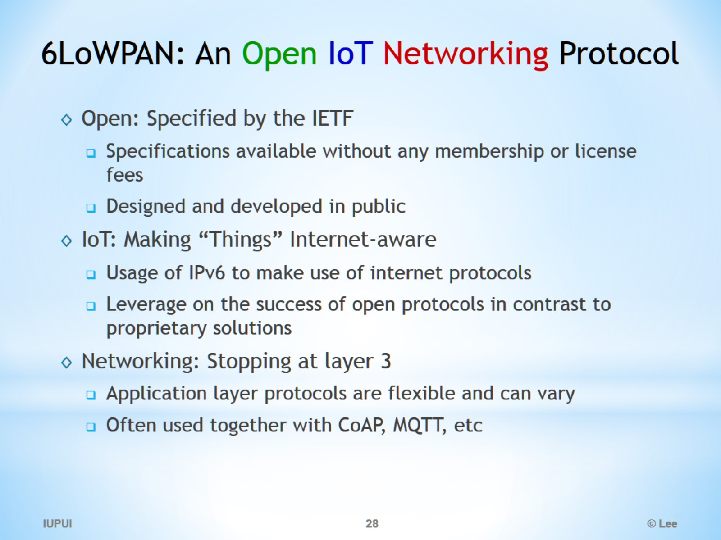
6LoWPAN: An Open IoT Networking Protocol

Slide 29
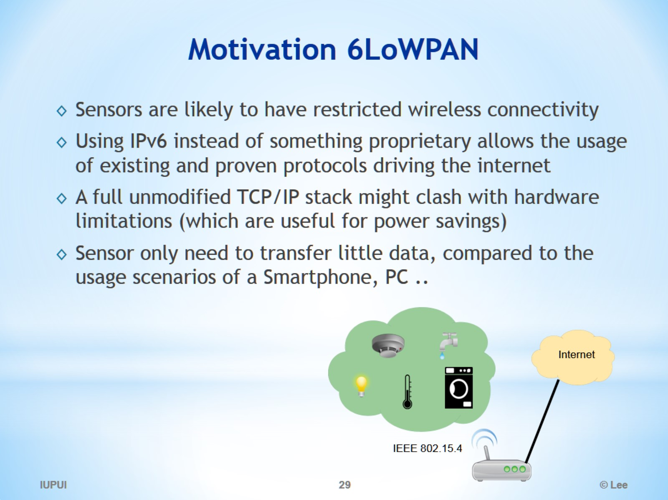
Motivation 6LoWPAN

Slide 30
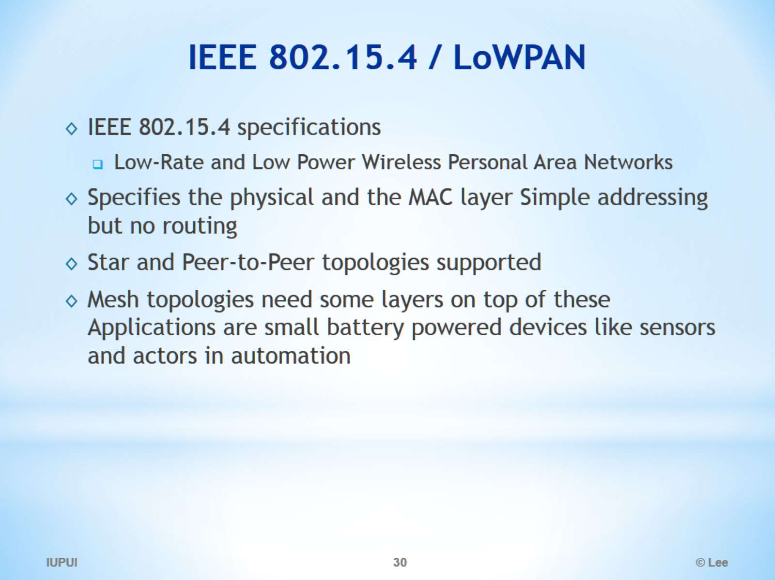
IEEE 802.15.4 / LoWPAN

Slide 31
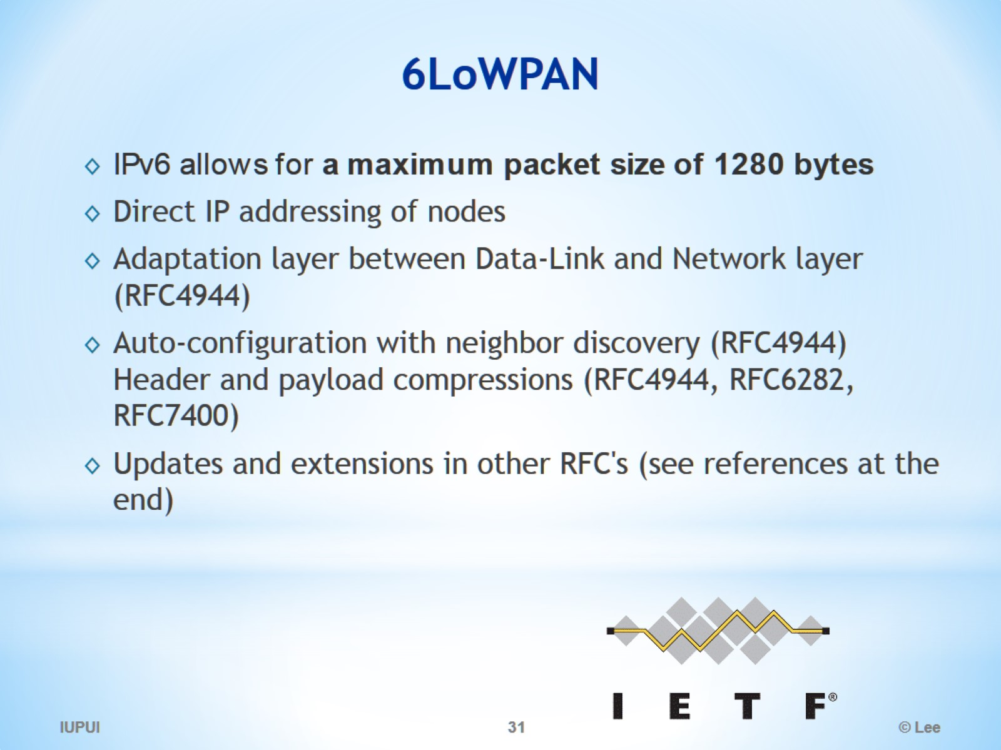
6LoWPAN

Slide 32
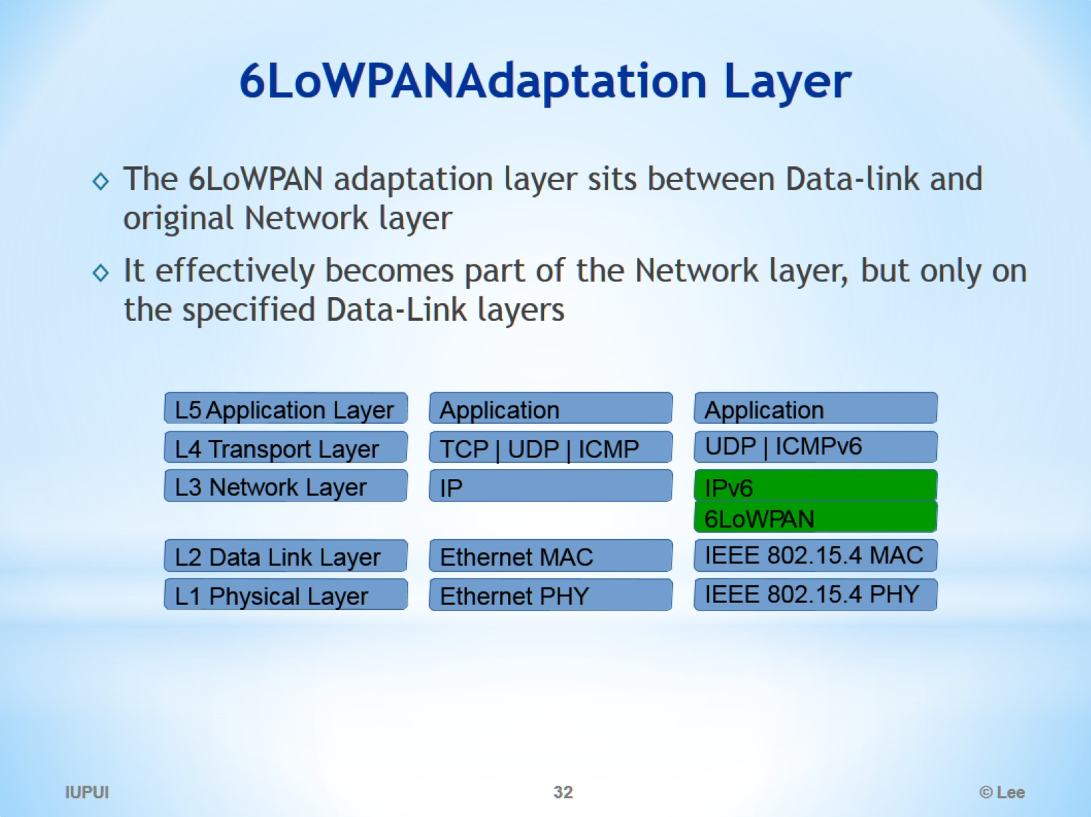
6LoWPAN Adaptation Layer

Slide 33
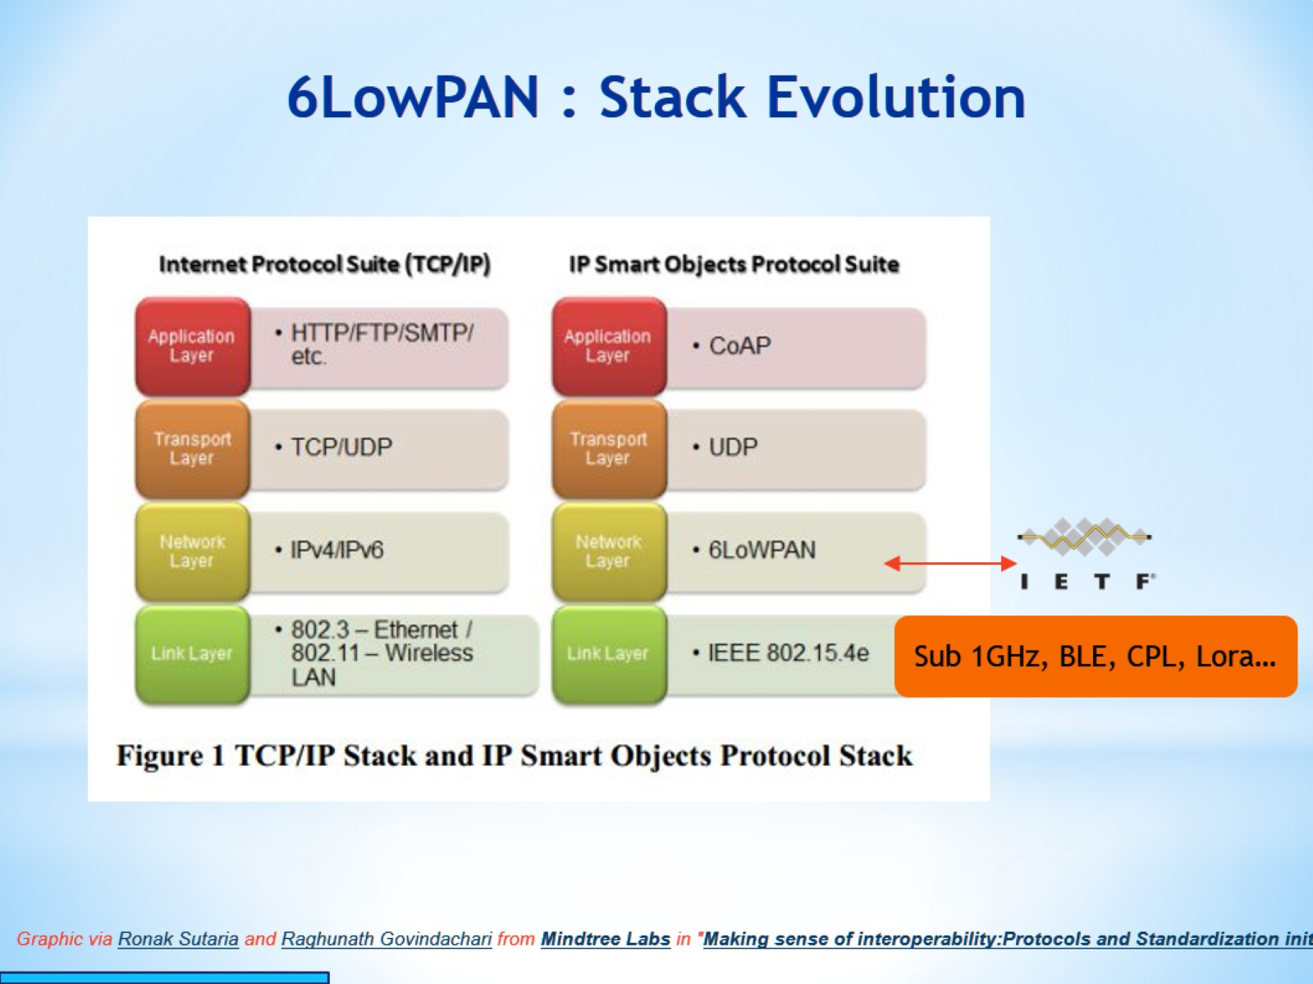
6LowPAN : Stack Evolution

Slide 34
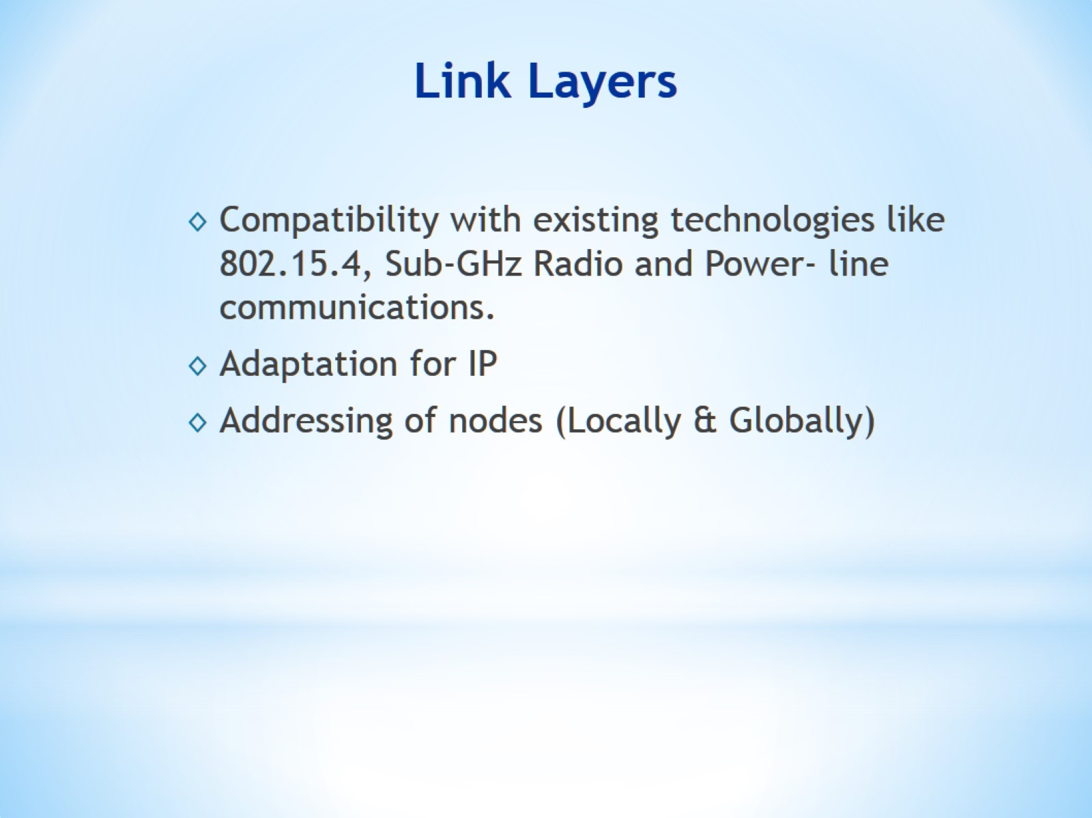
Link Layers

Slide 35
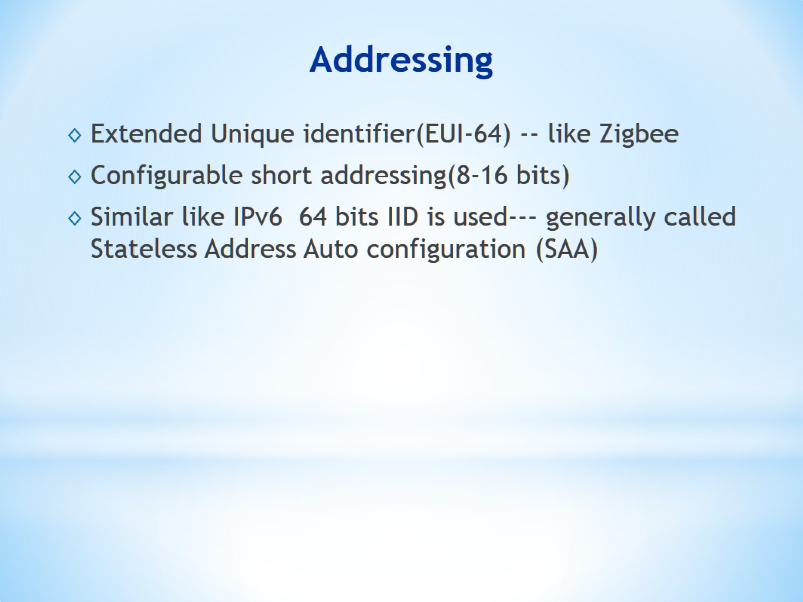
Addressing

Slide 36
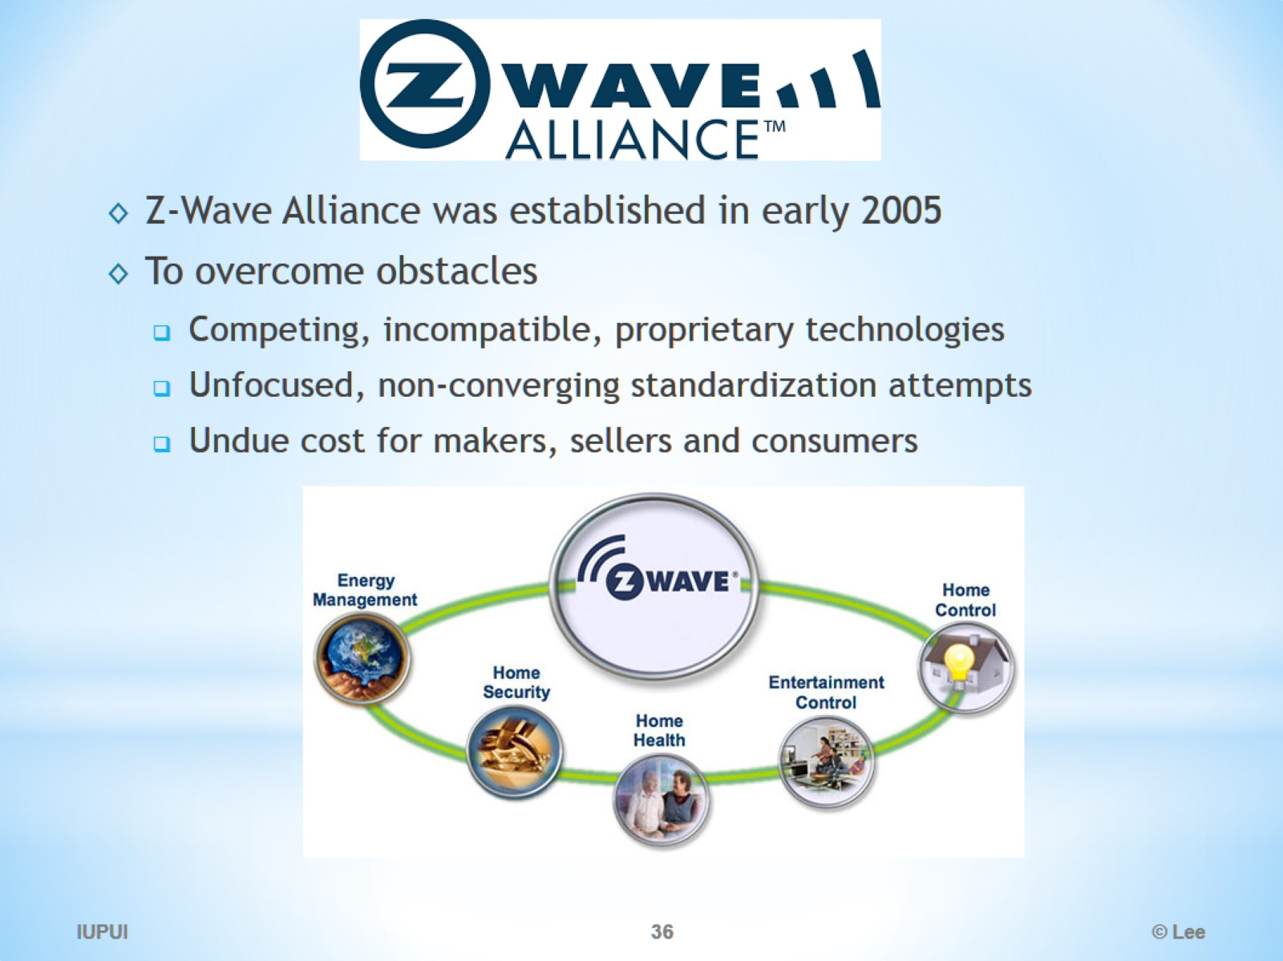
Zwave

Slide 37
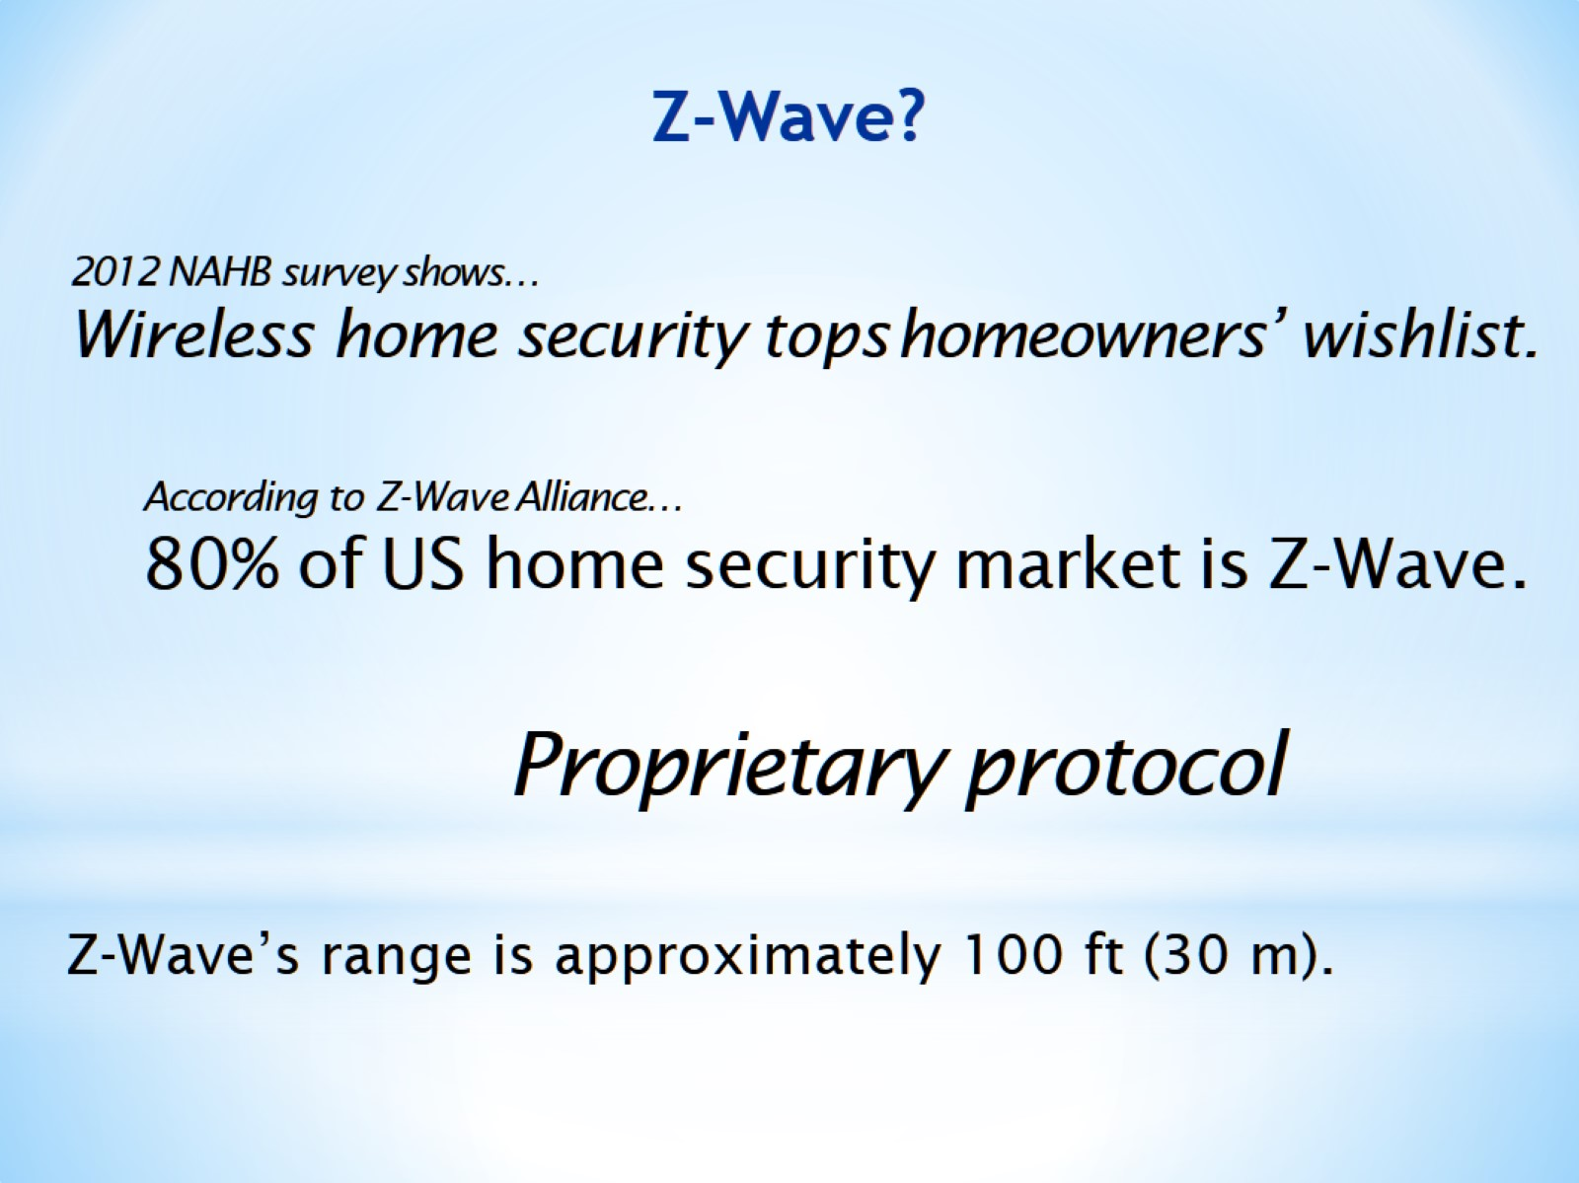
Z-Wave?

Slide 38
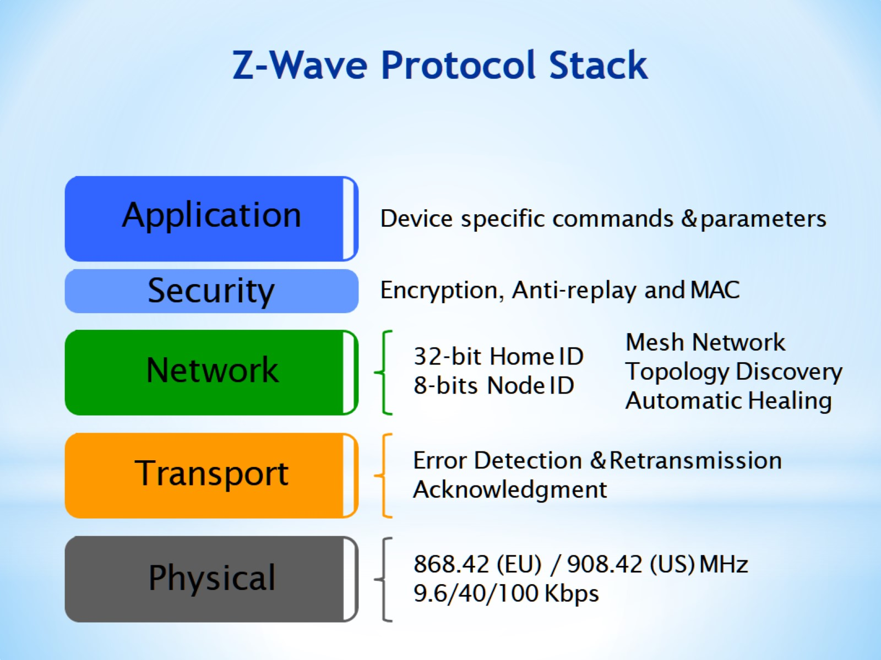
Z-Wave Protocol Stack

Slide 39
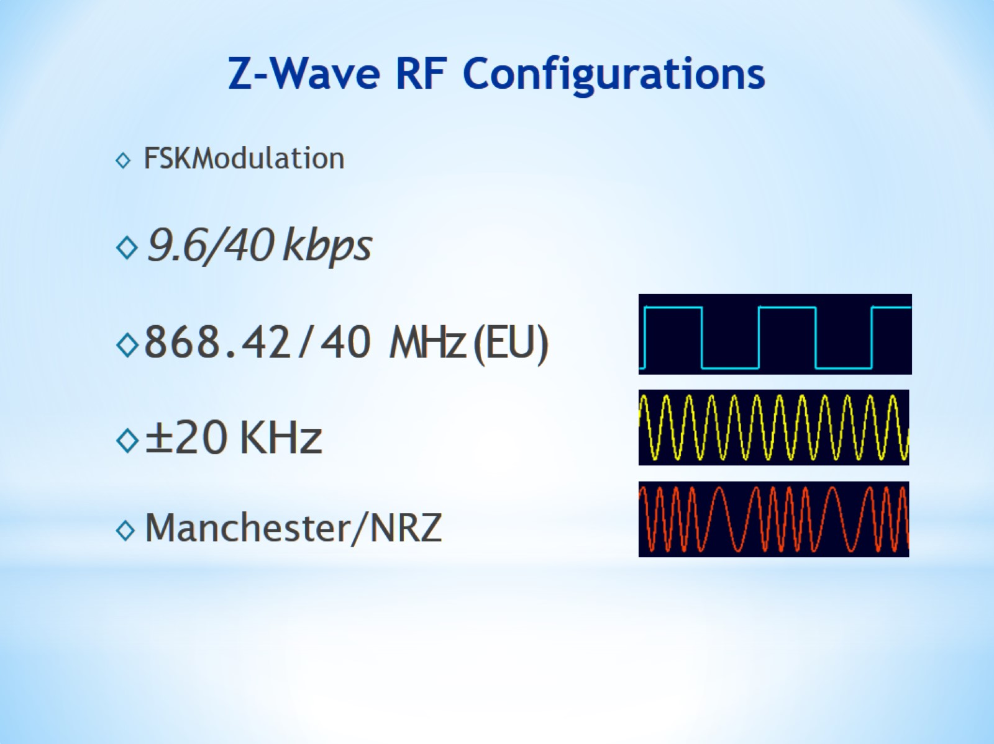
Z-Wave RF Configurations

Slide 40
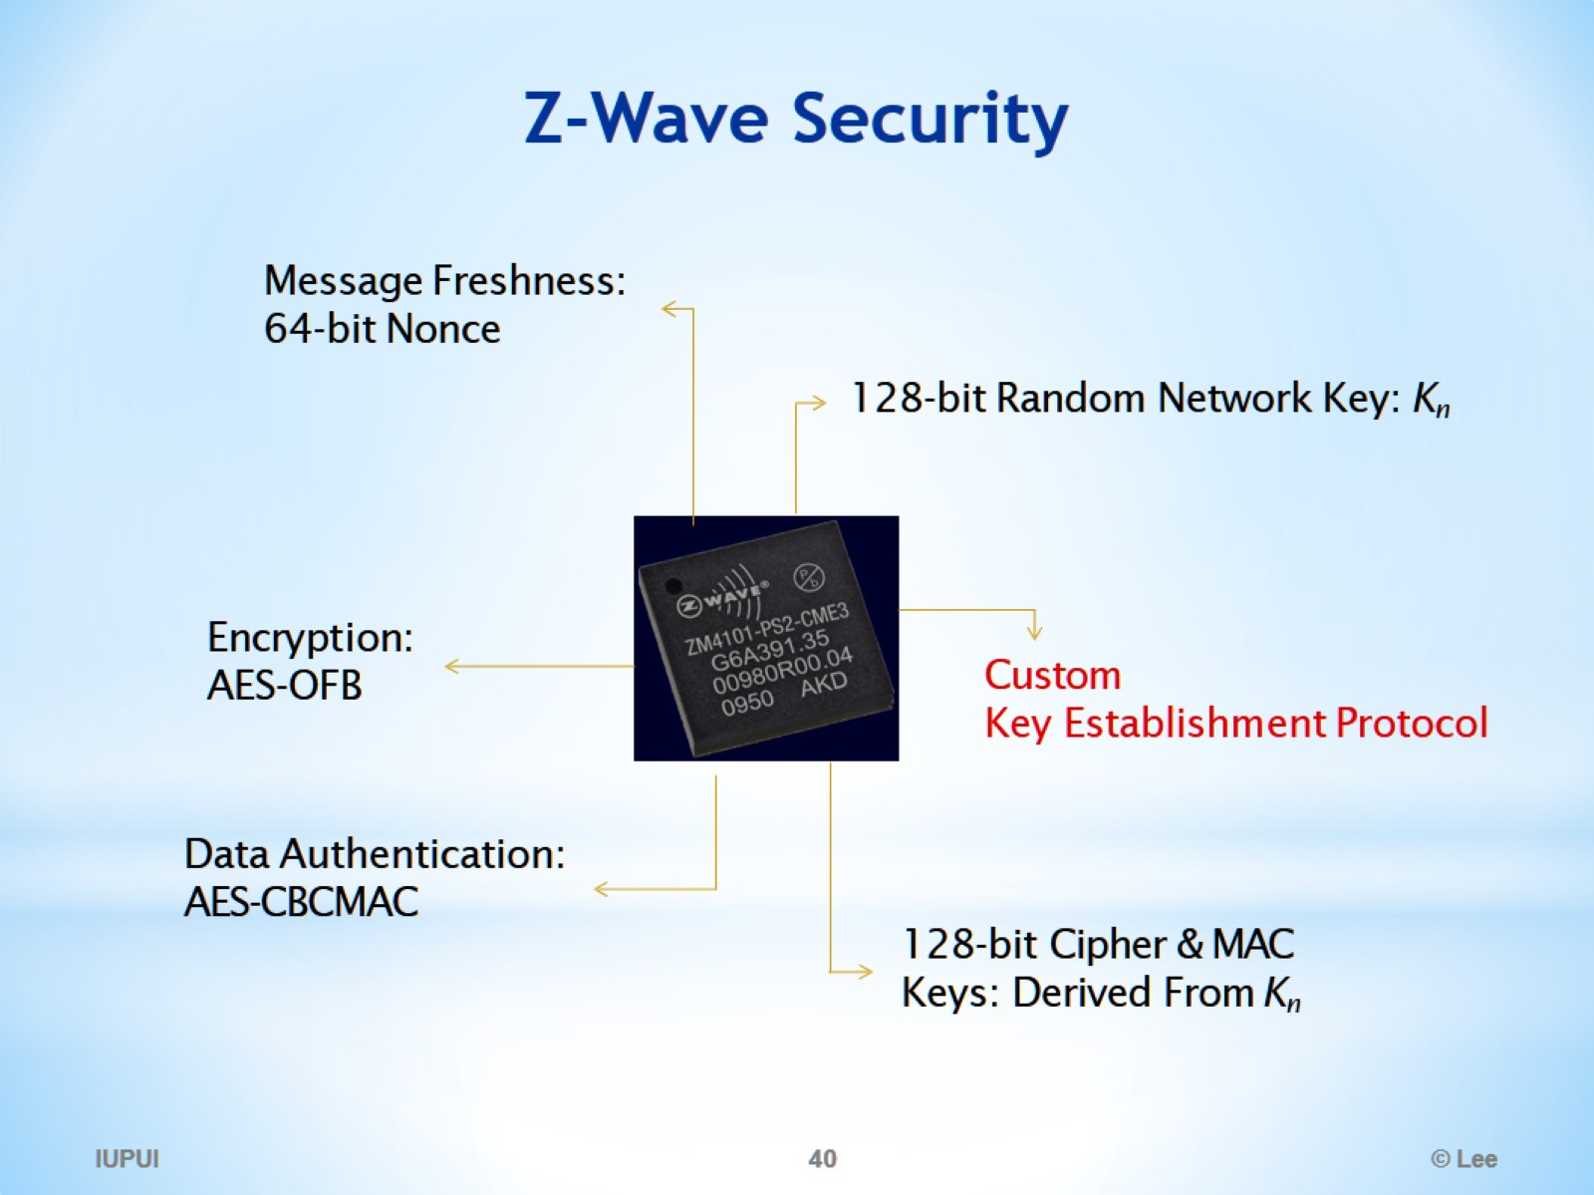
Z-Wave Security

Slide 41
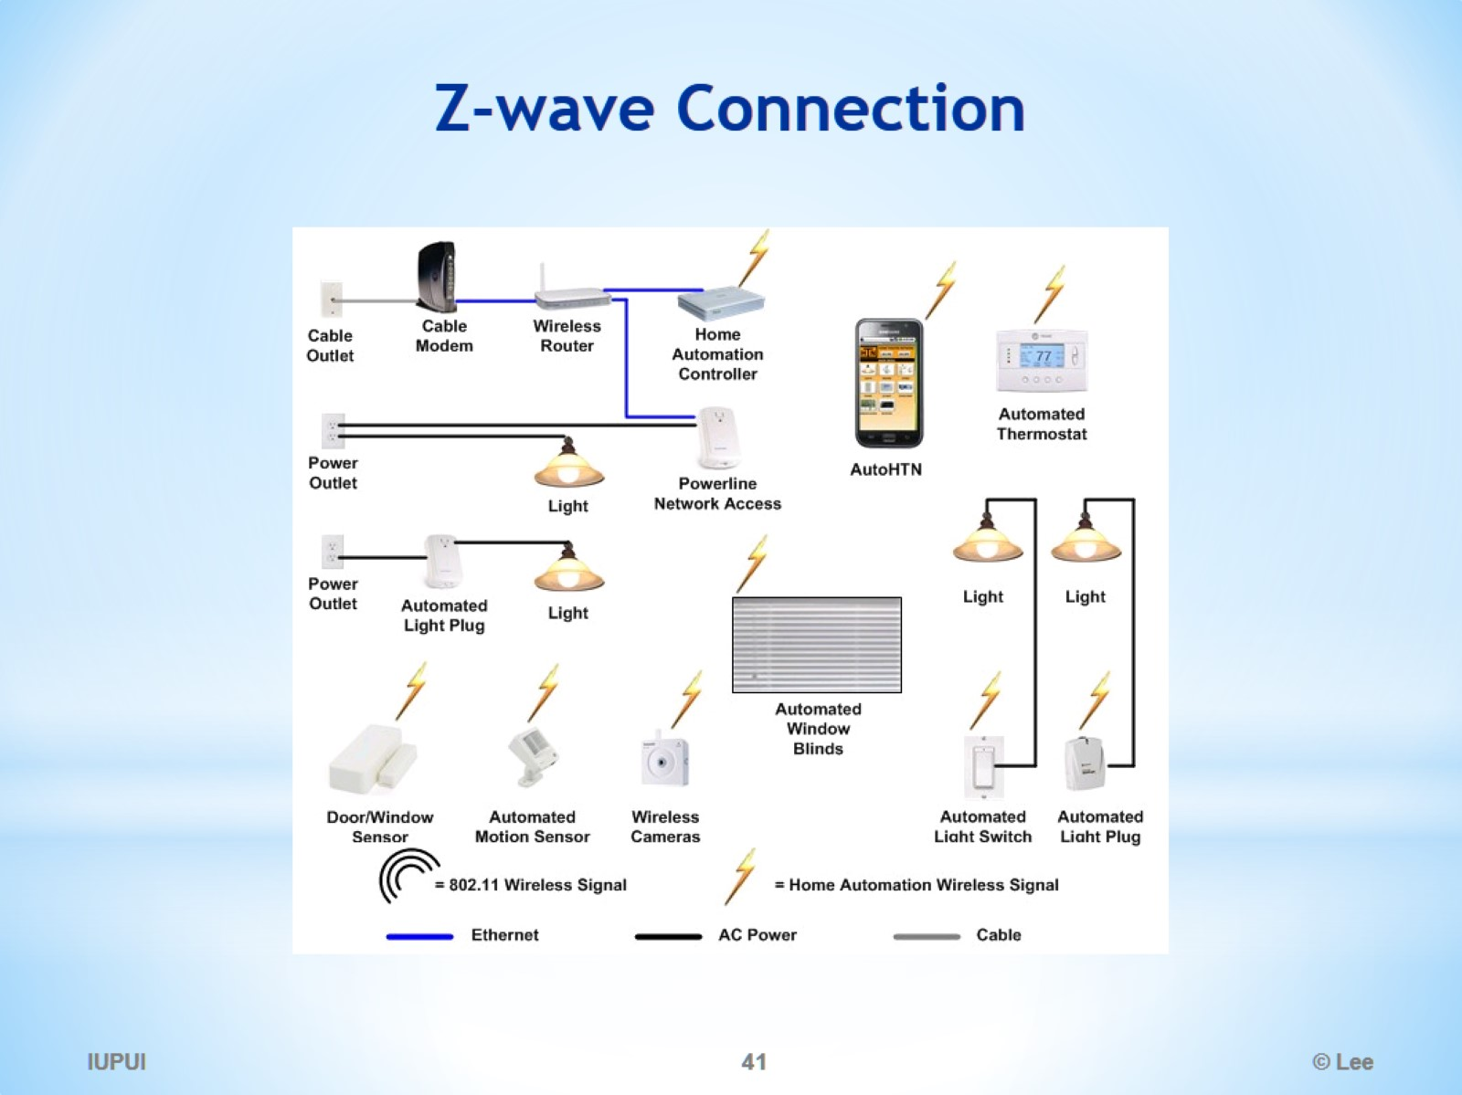
Z-wave Connection

Slide 42
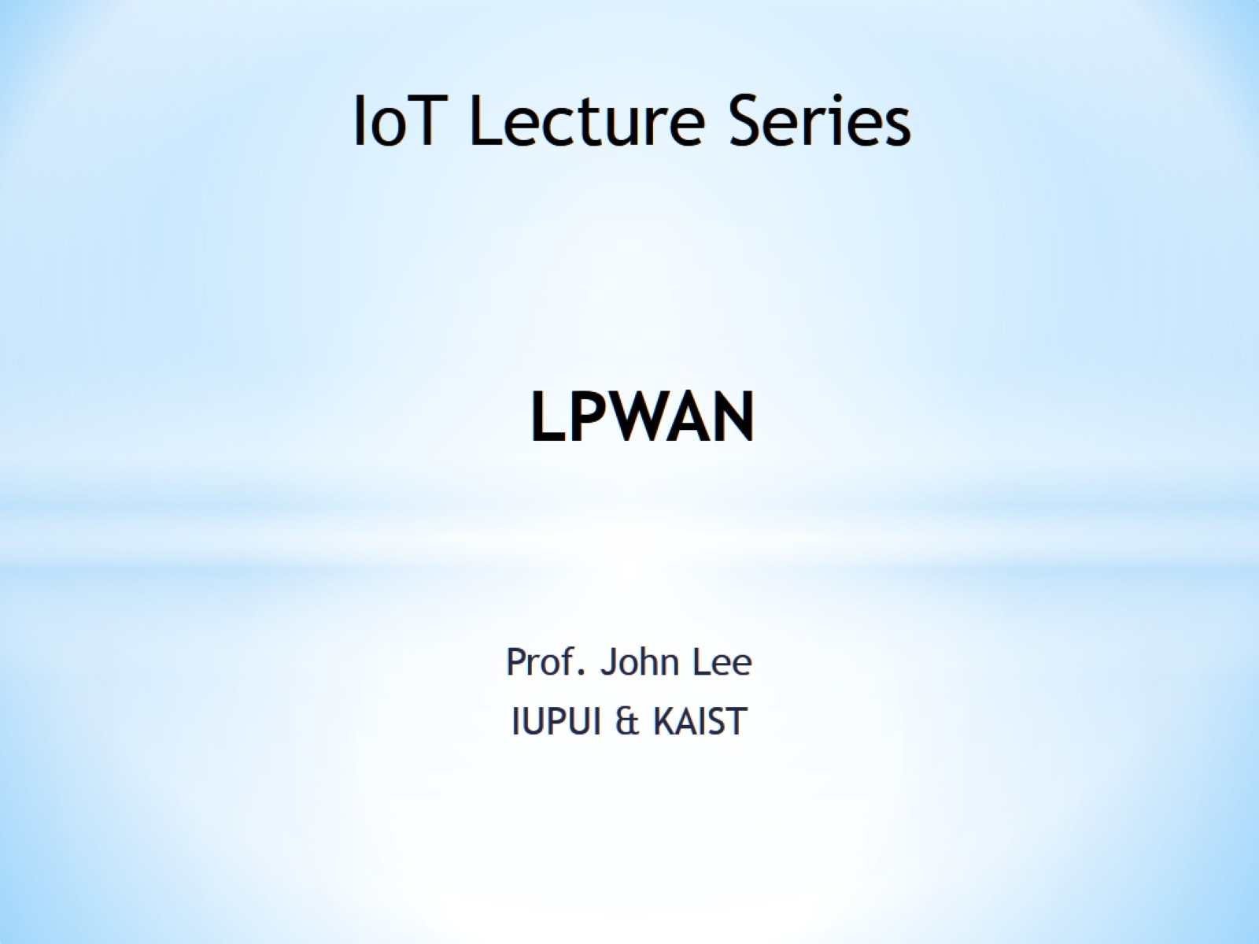
LPWAN

Slide 43
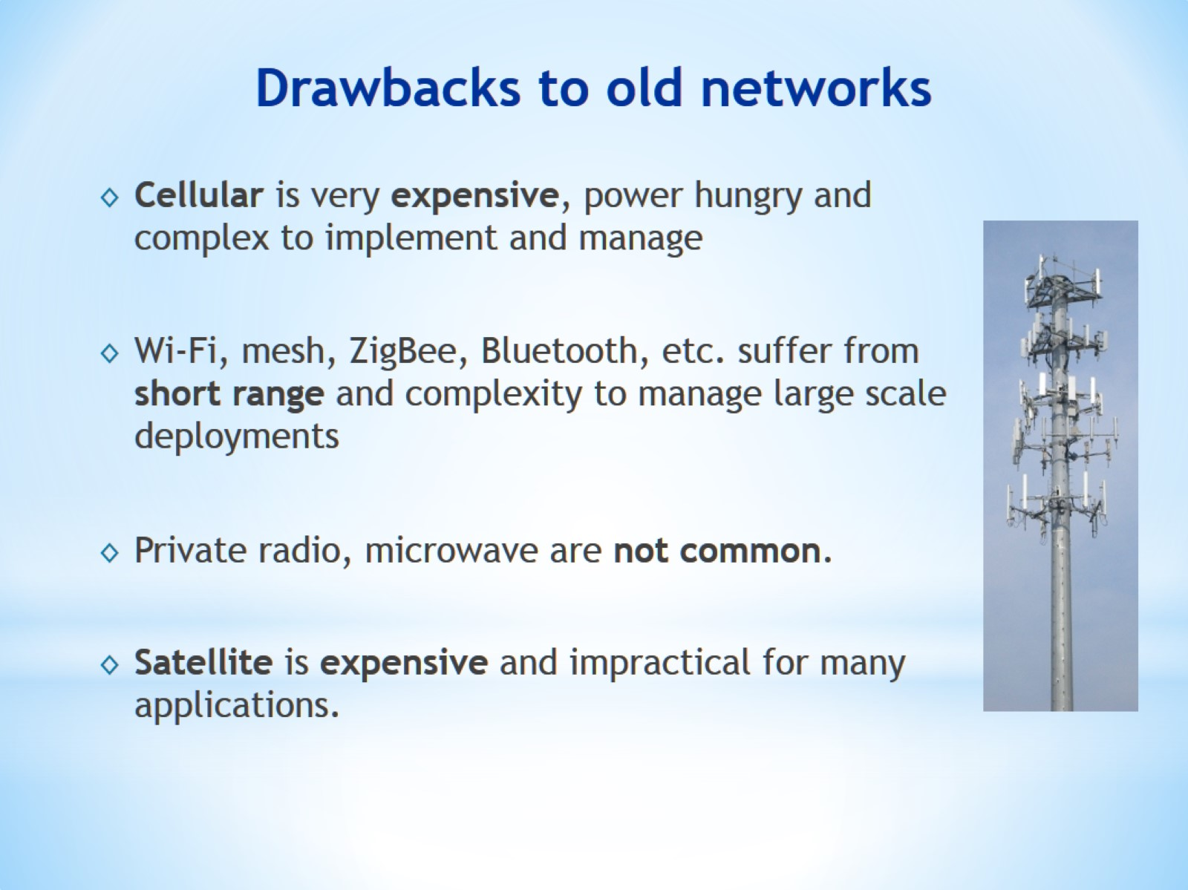
Drawbacks to old networks

Slide 44
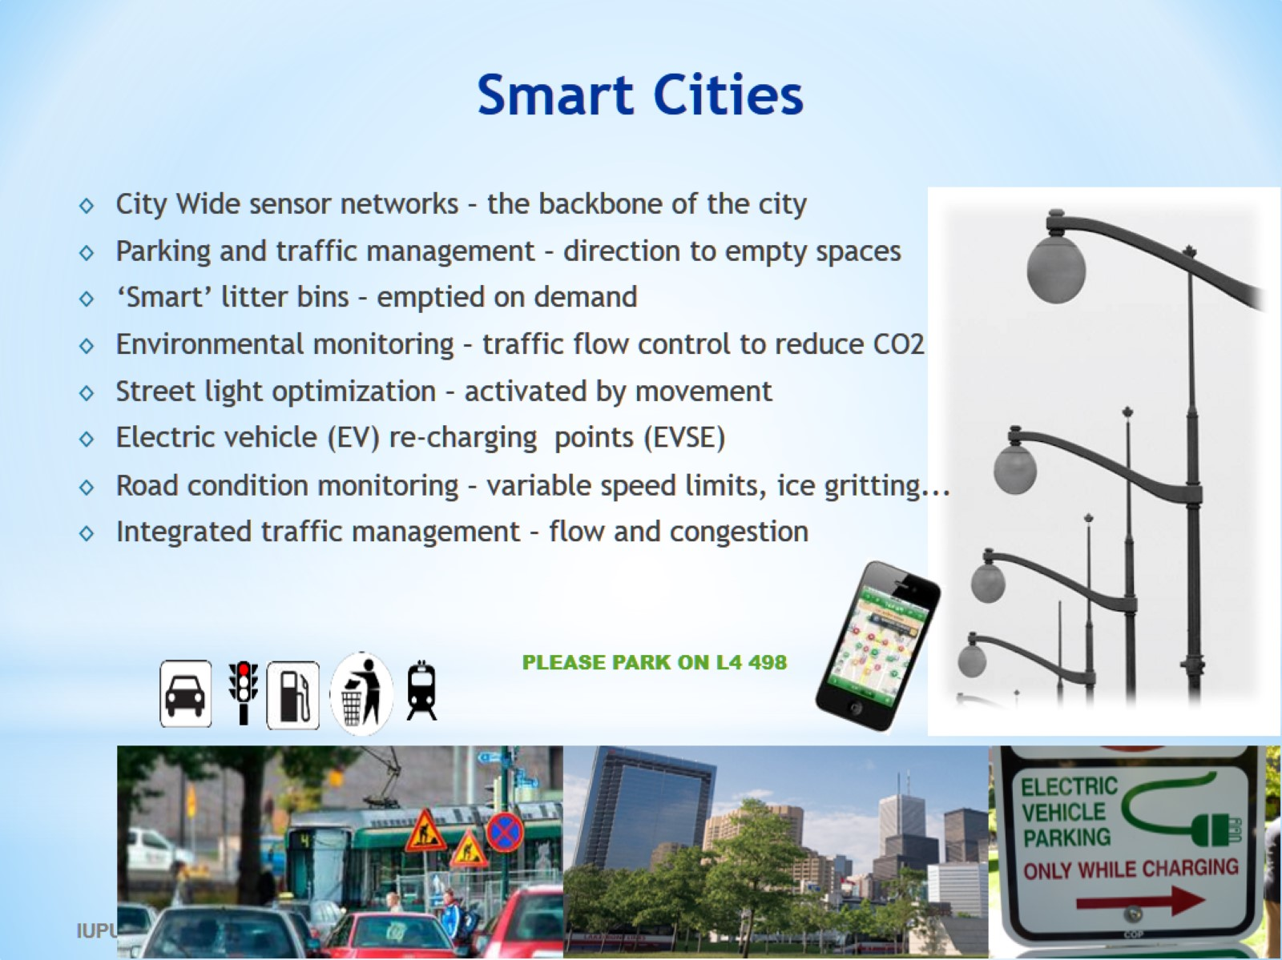
Smart Cities

Slide 45
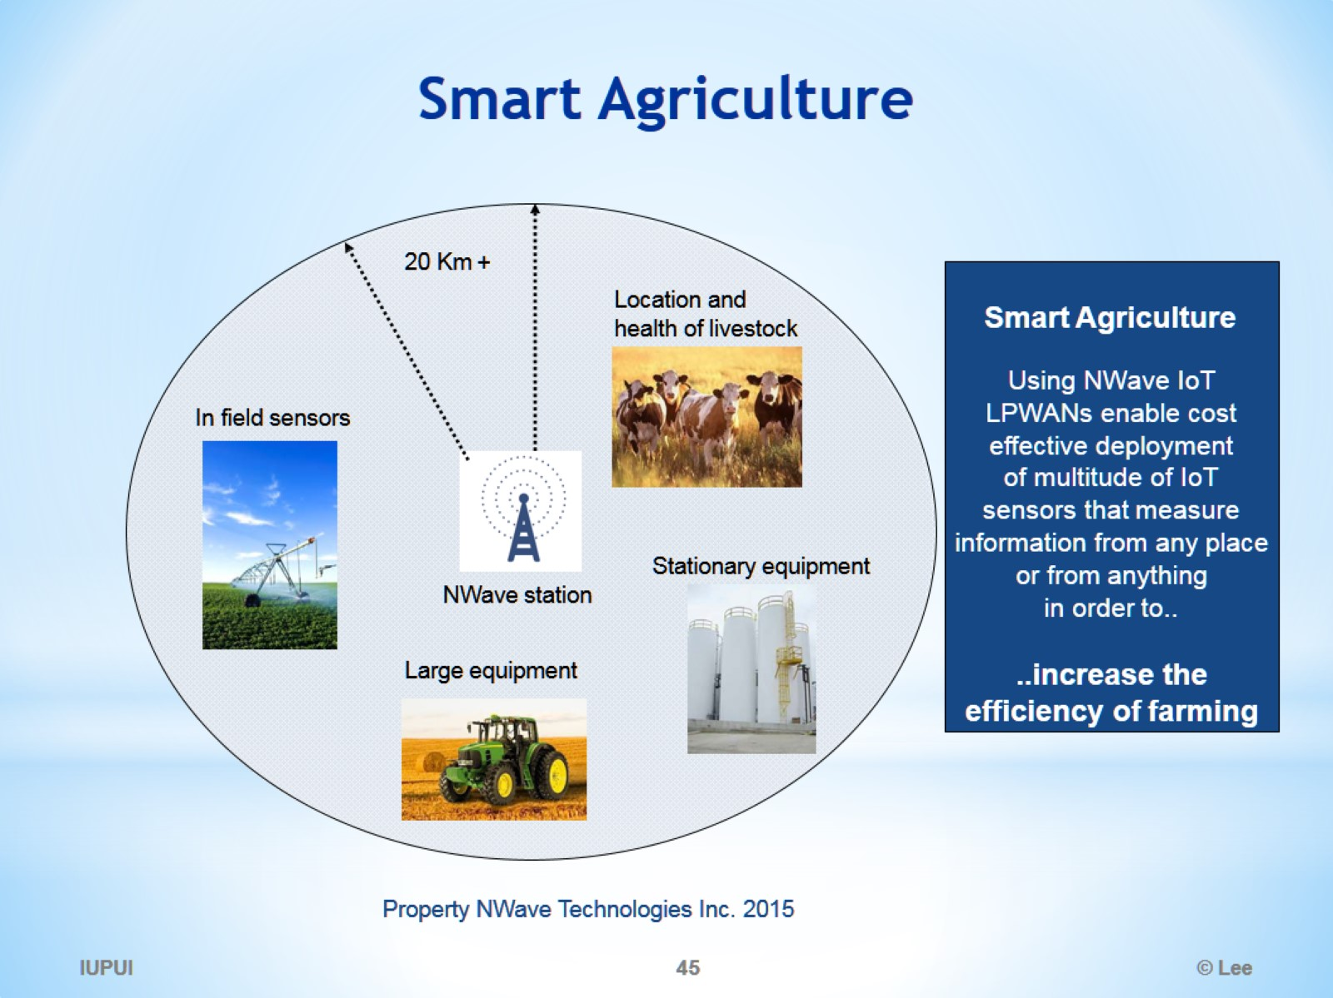
Smart Agriculture

Slide 46
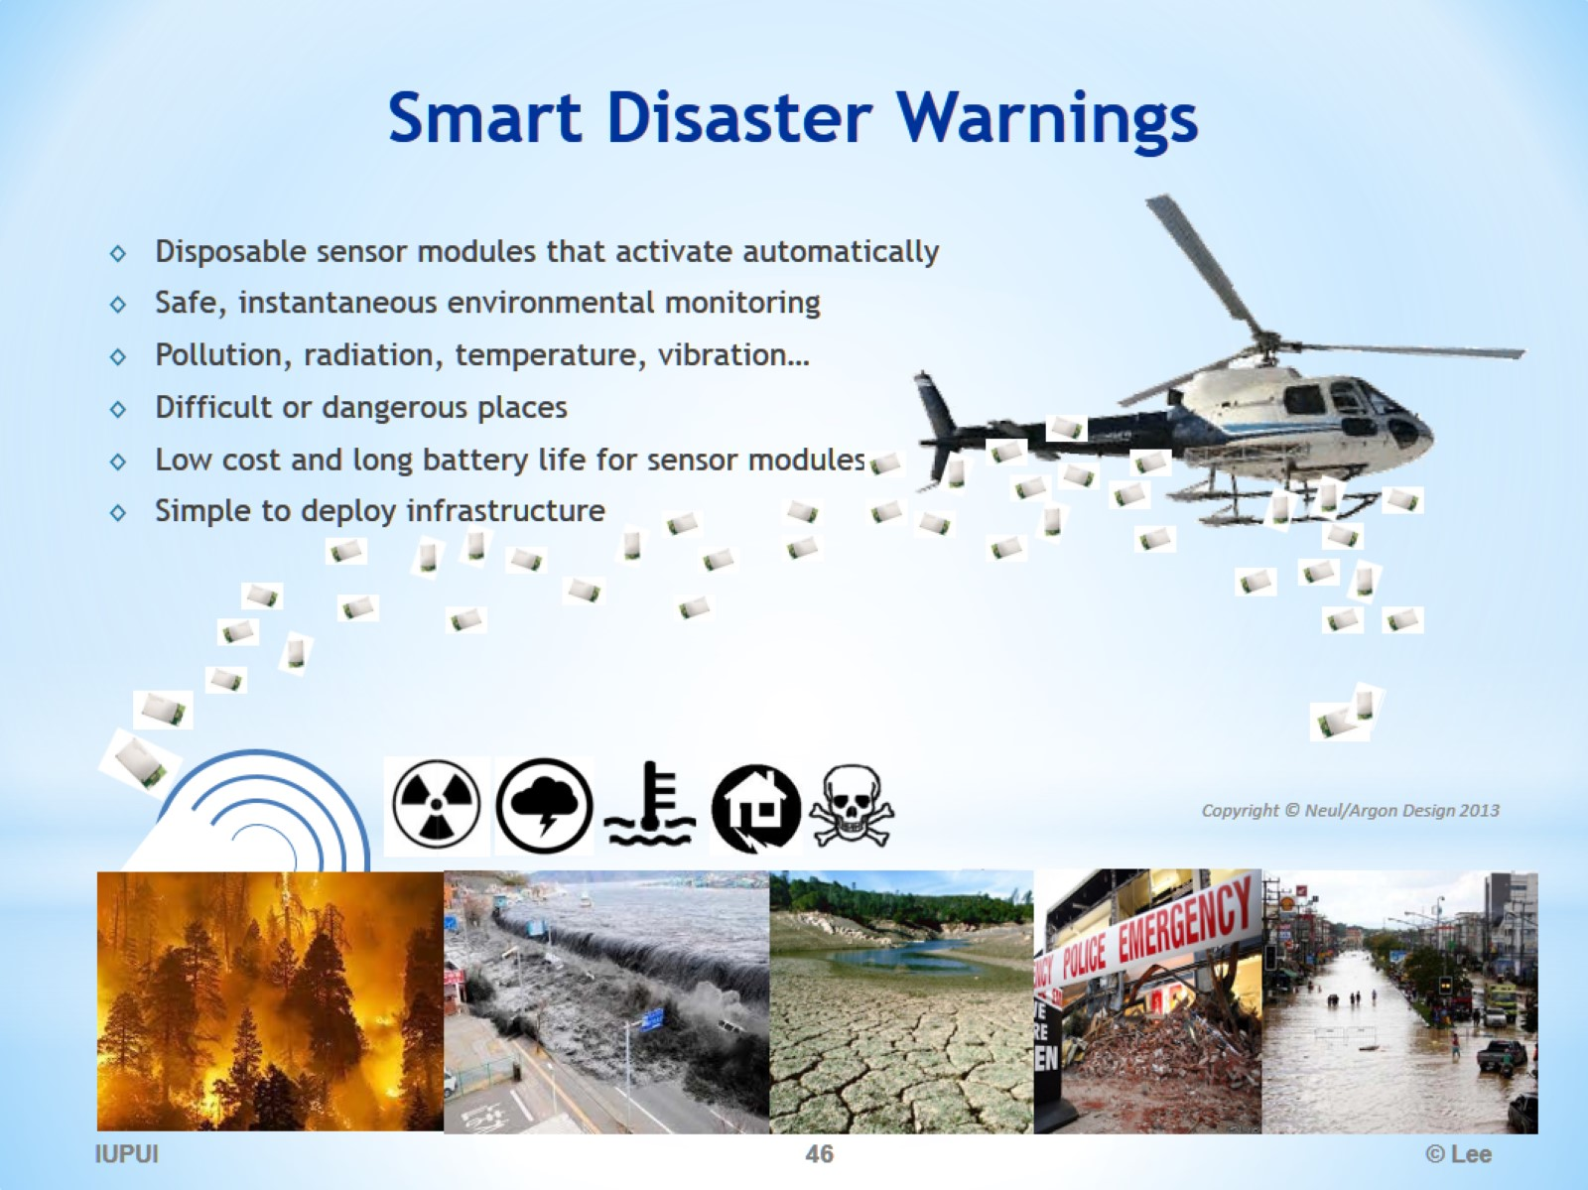
Smart Disaster Warnings

Slide 47
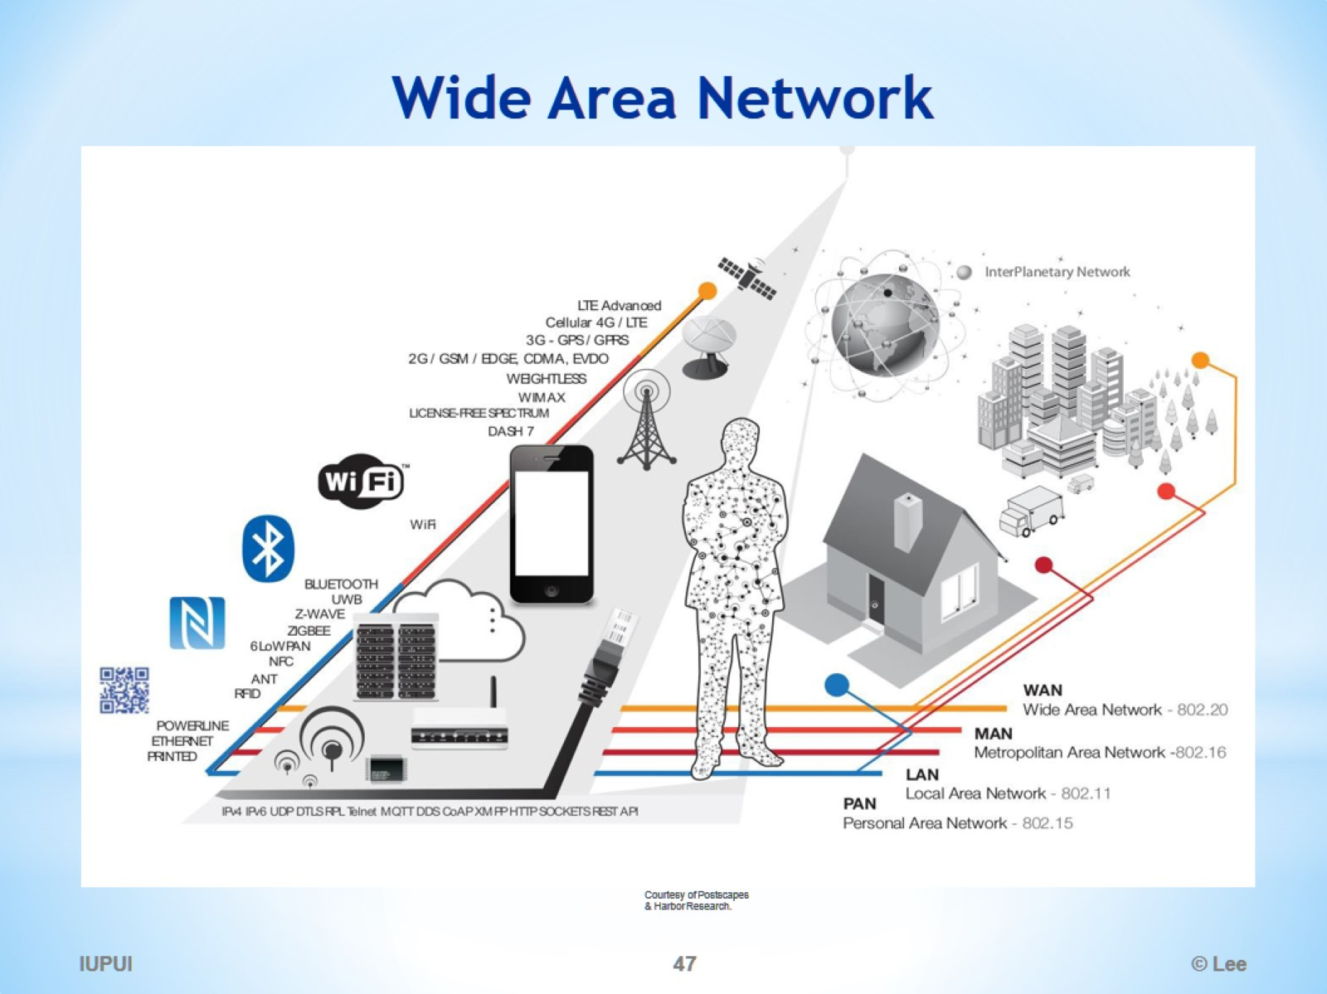
Wide Area Network

Slide 48
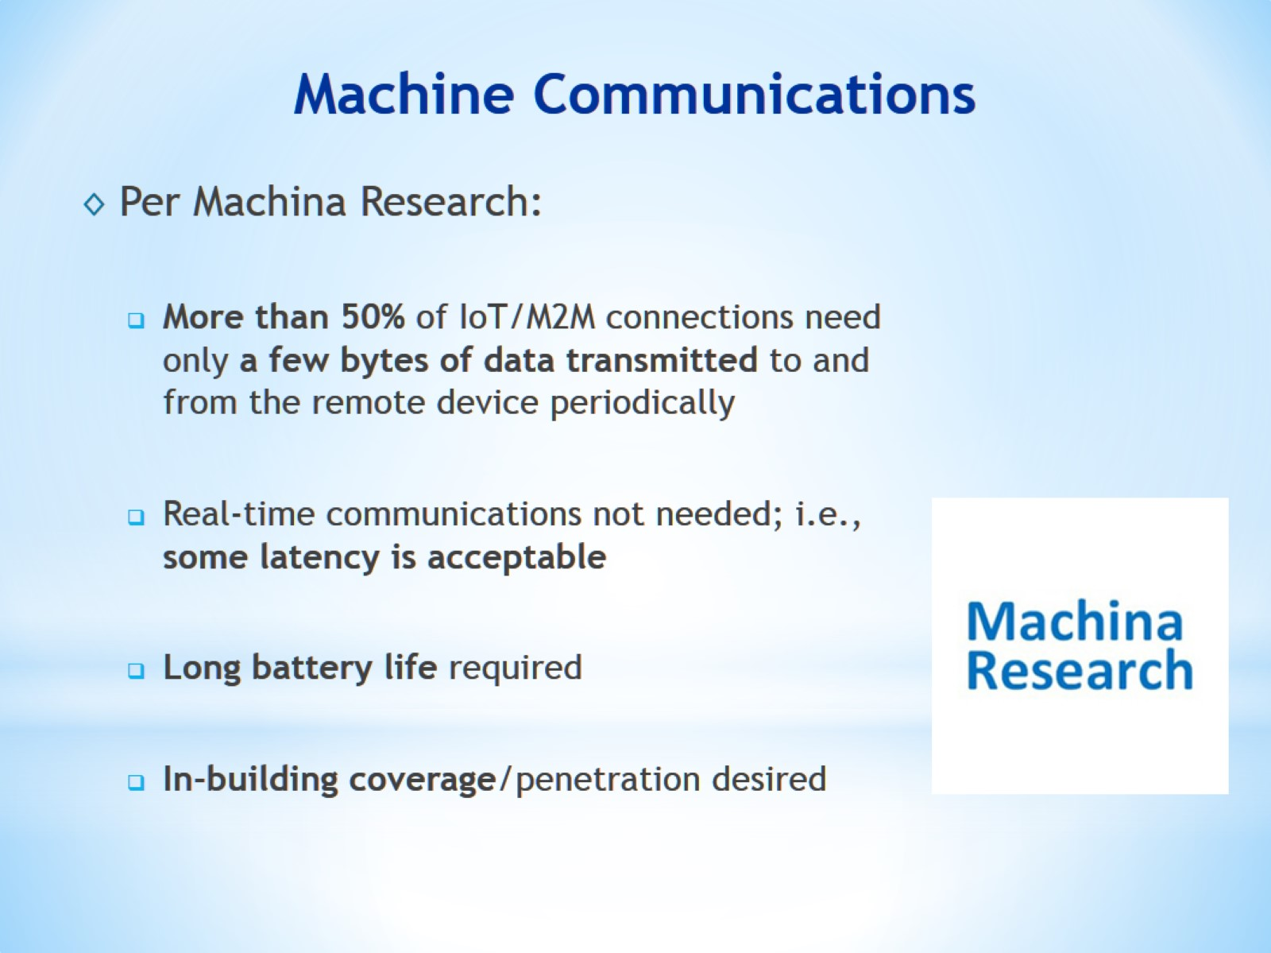
Machine Communications

Slide 49
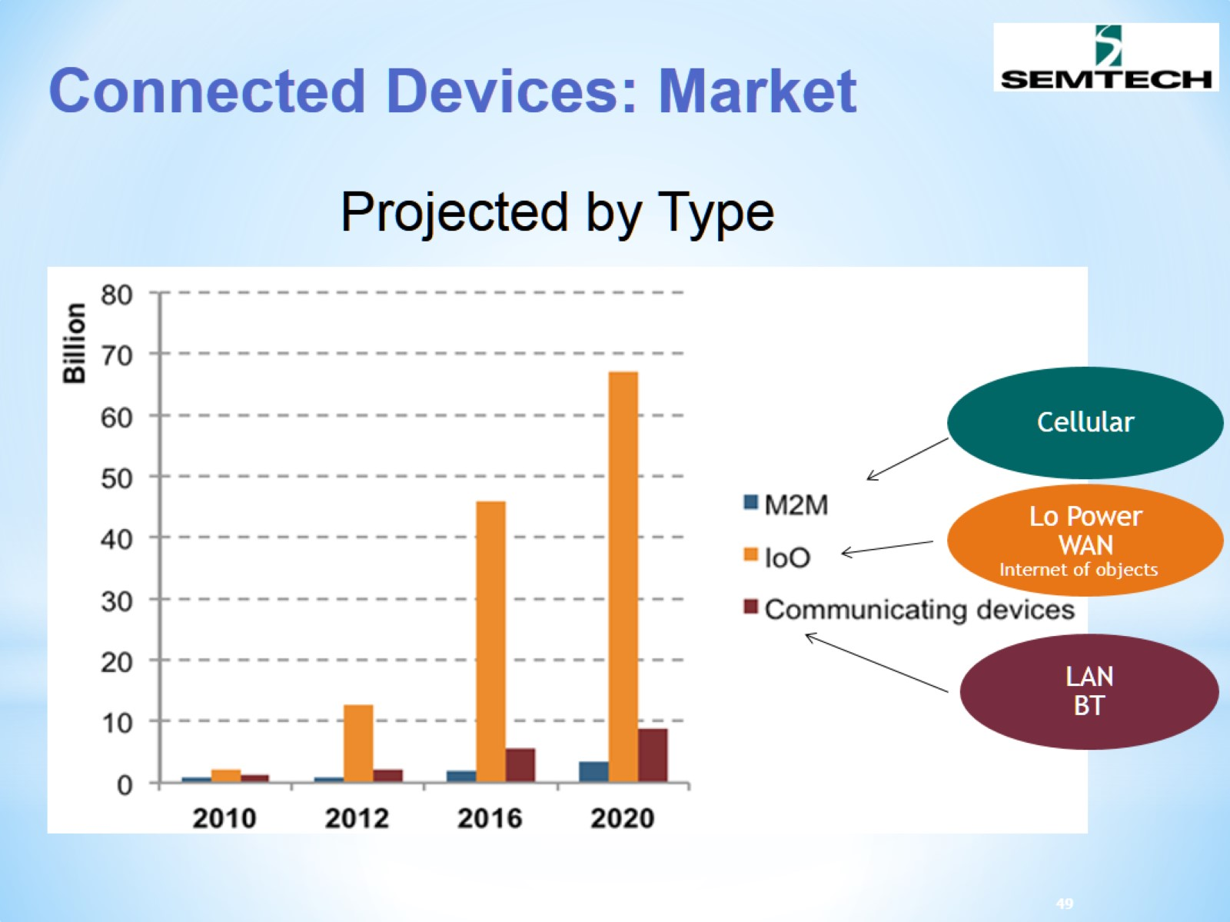
Connected Devices: Market

Slide 50
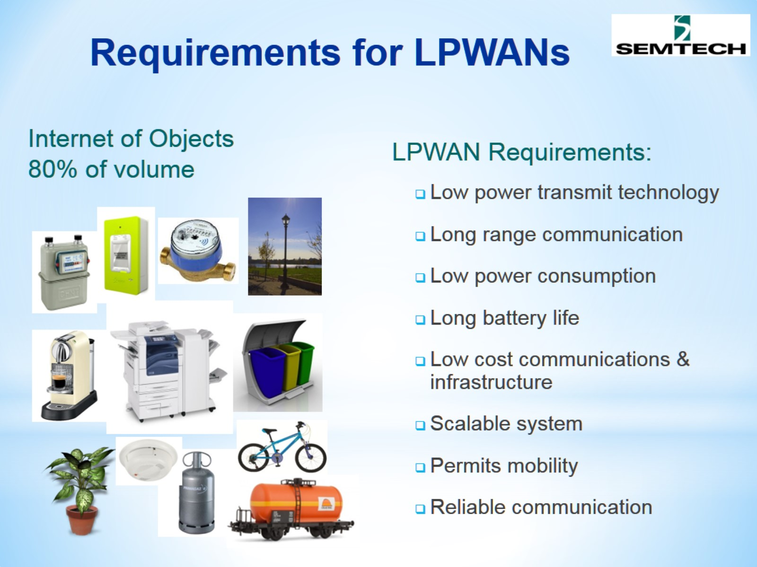
Requirements for LPWANs

Slide 51

Low Power Wide Area Network (LPWAN)

Slide 52

Where does LPWAN stand?

Slide 53

New IoT Network based on LPWAN

Slide 54

LPWAN (Low-Power, Wide Area Network)

Slide 55

Channel Bands for IoT

Slide 56

TV White Space for IoT Cellular Data Communication

Slide 57

ISM Band for IoT Cellular Data Comms

Slide 58

LPWAN Building Blocks for IoT Solutions

Slide 59

IoT LPWAN Architecture

Slide 60

Two types of IoT LPWAN Networks

Slide 61

SigFox

Slide 62

SigFox Specifications

Slide 63

SigFox Use Examples

Slide 64

SigFox Embedded

Slide 65


Slide 66

LoRaWAN (LoRa + network layers)

Slide 67

LoRa-Alliance Members

Slide 68

NB-CIoT vs NB-LTE

Slide 69

NB-CIoT vs NB-LTE

Slide 70

NB-LTE Supporting Members

